Slide 1
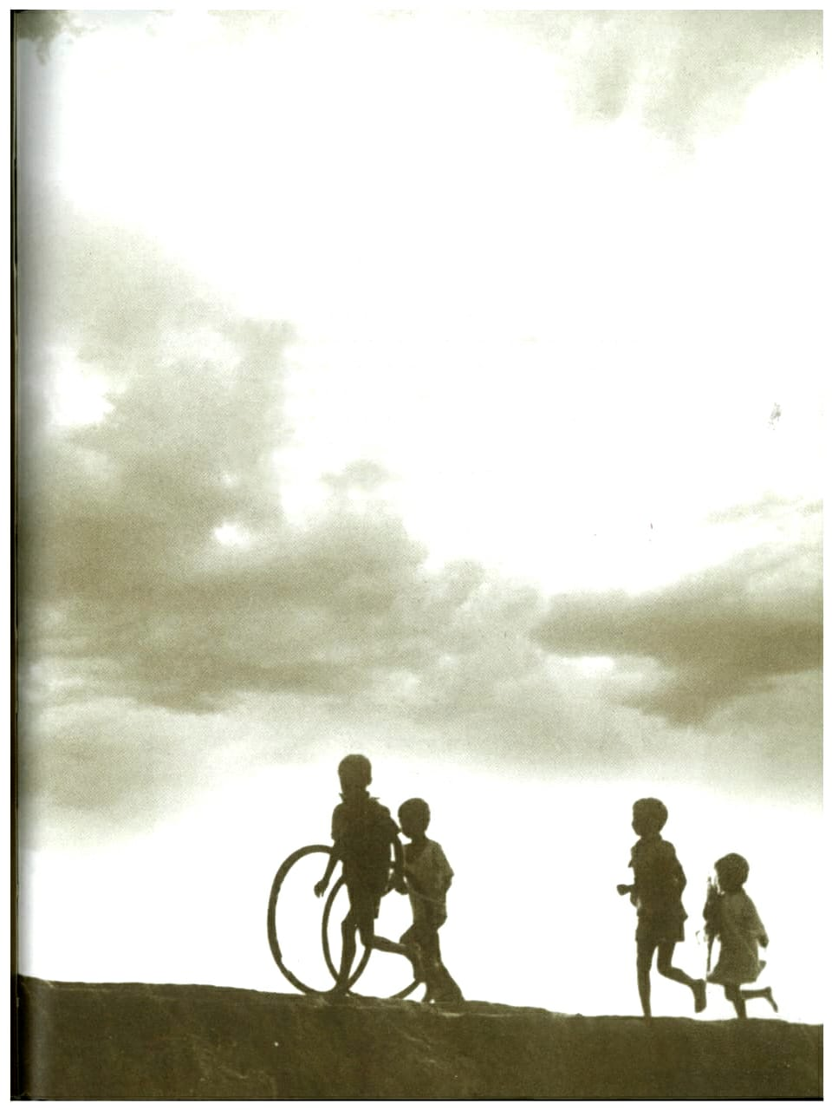
A STUDY ON THE THERAPEUTIC POTENTIAL OF NATURE WITH REFERENCE TO PSALMS AND GITANJALI
Research Supervisor
Dr. M. Ashitha Varghese,
Assistant Professor,
Department of English,
Bharathiar University.
Research Scholar
Fr. Roby. K. Sebastain,
Ph.D. Research Scholar,
Department of English,
Bharathiar University.

Slide 2
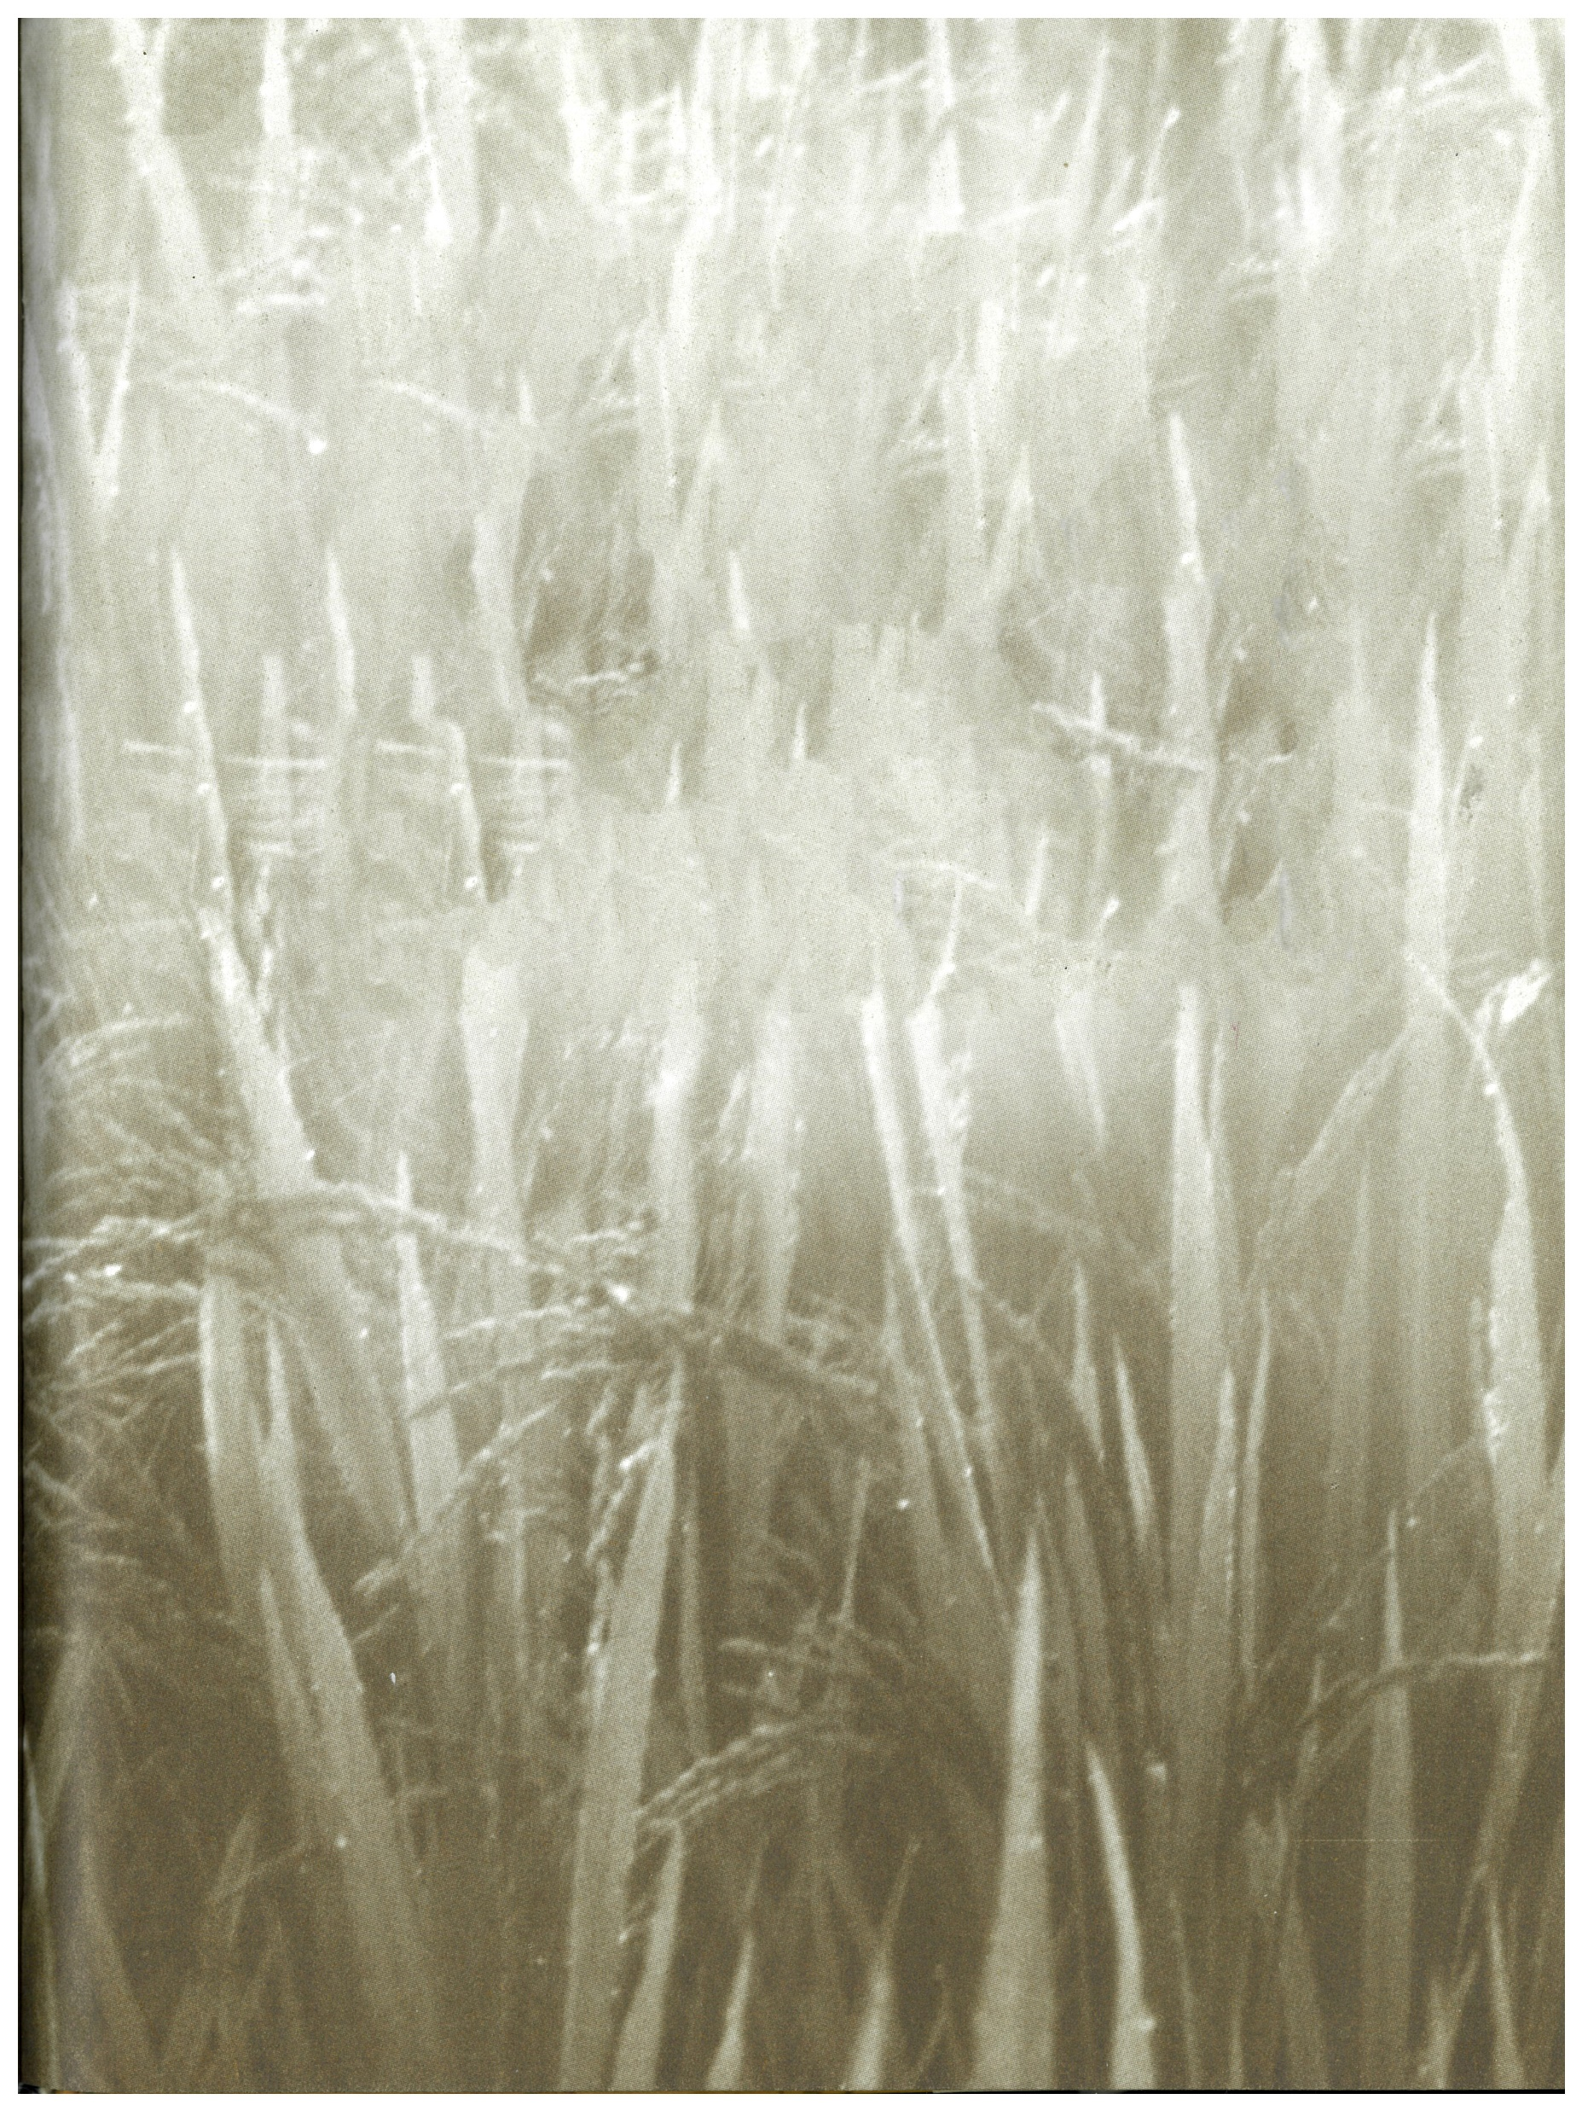
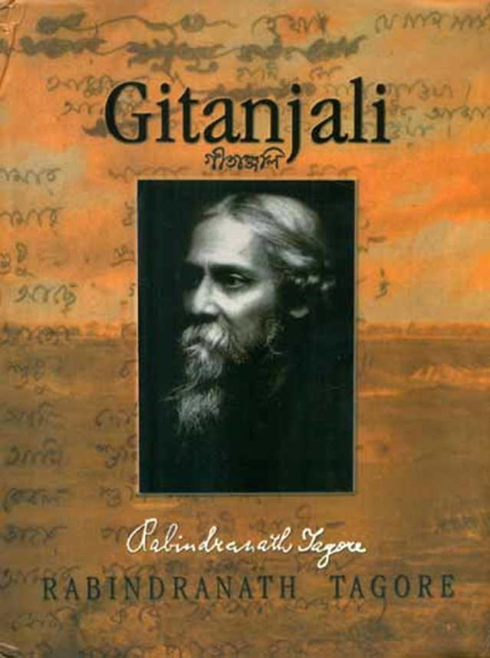
SELECT WORKS - PSALMS and GITANJALI

Slide 3
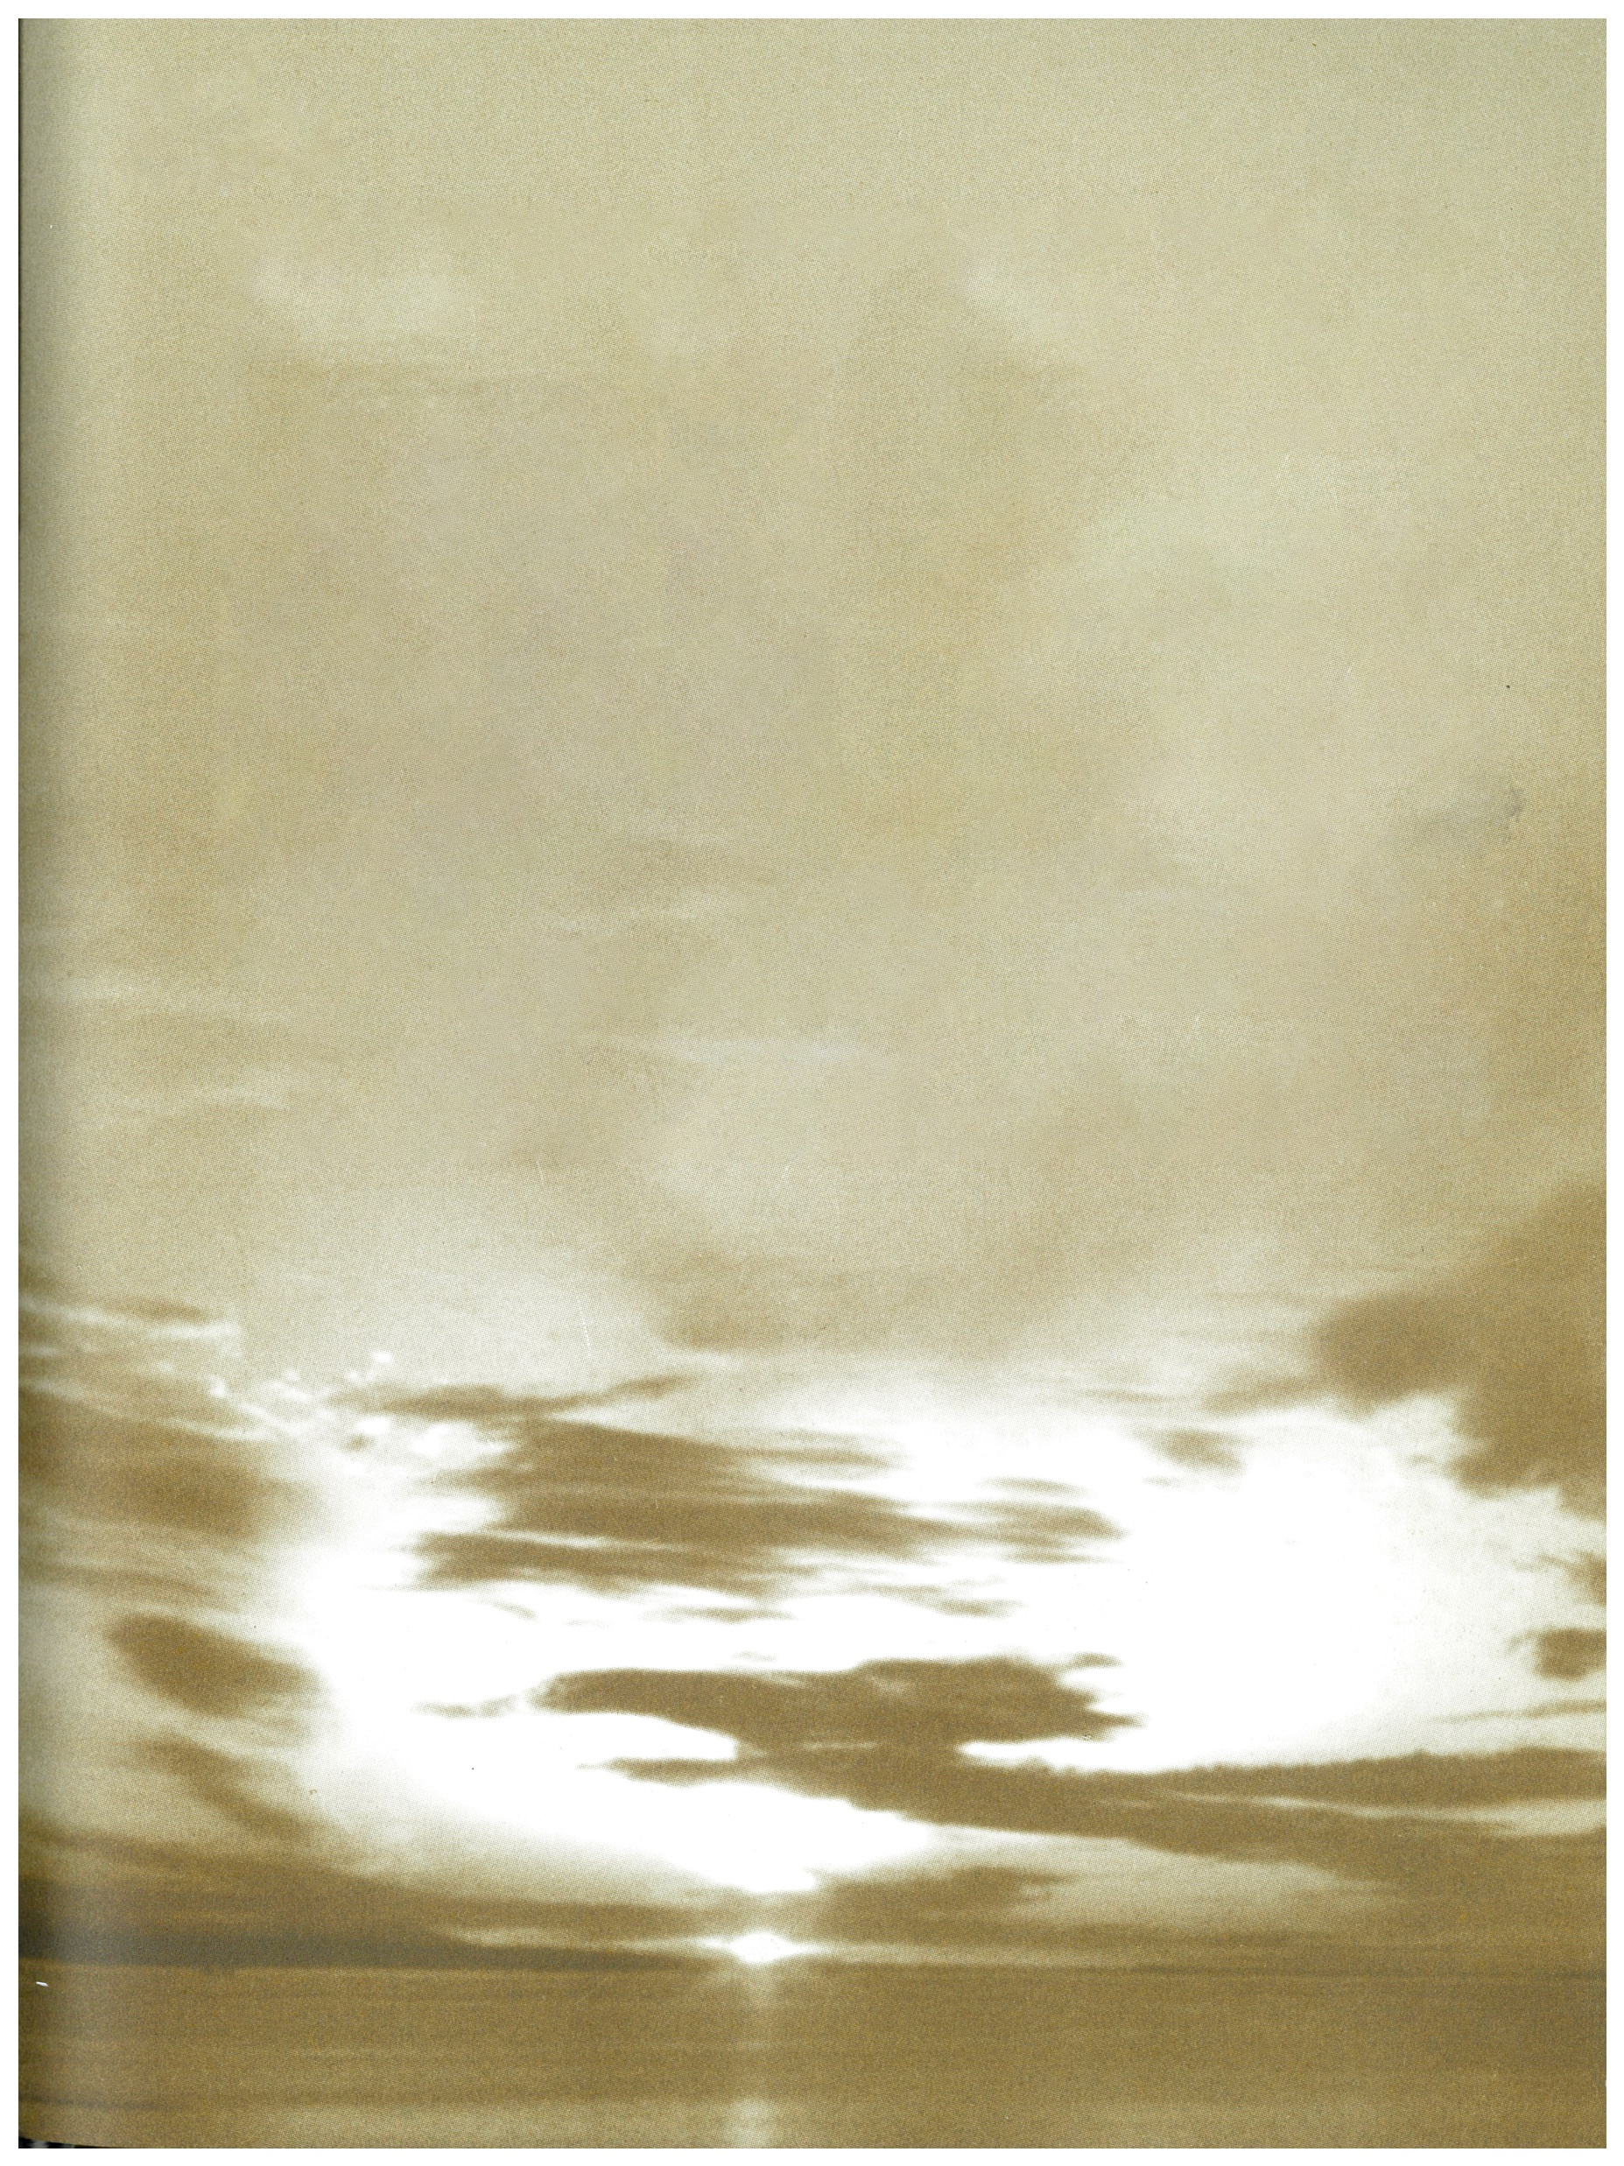
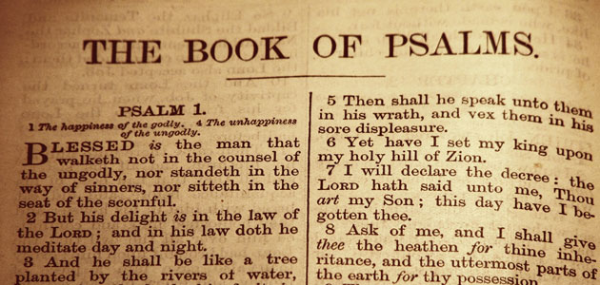
HOLY BIBLE

Slide 4
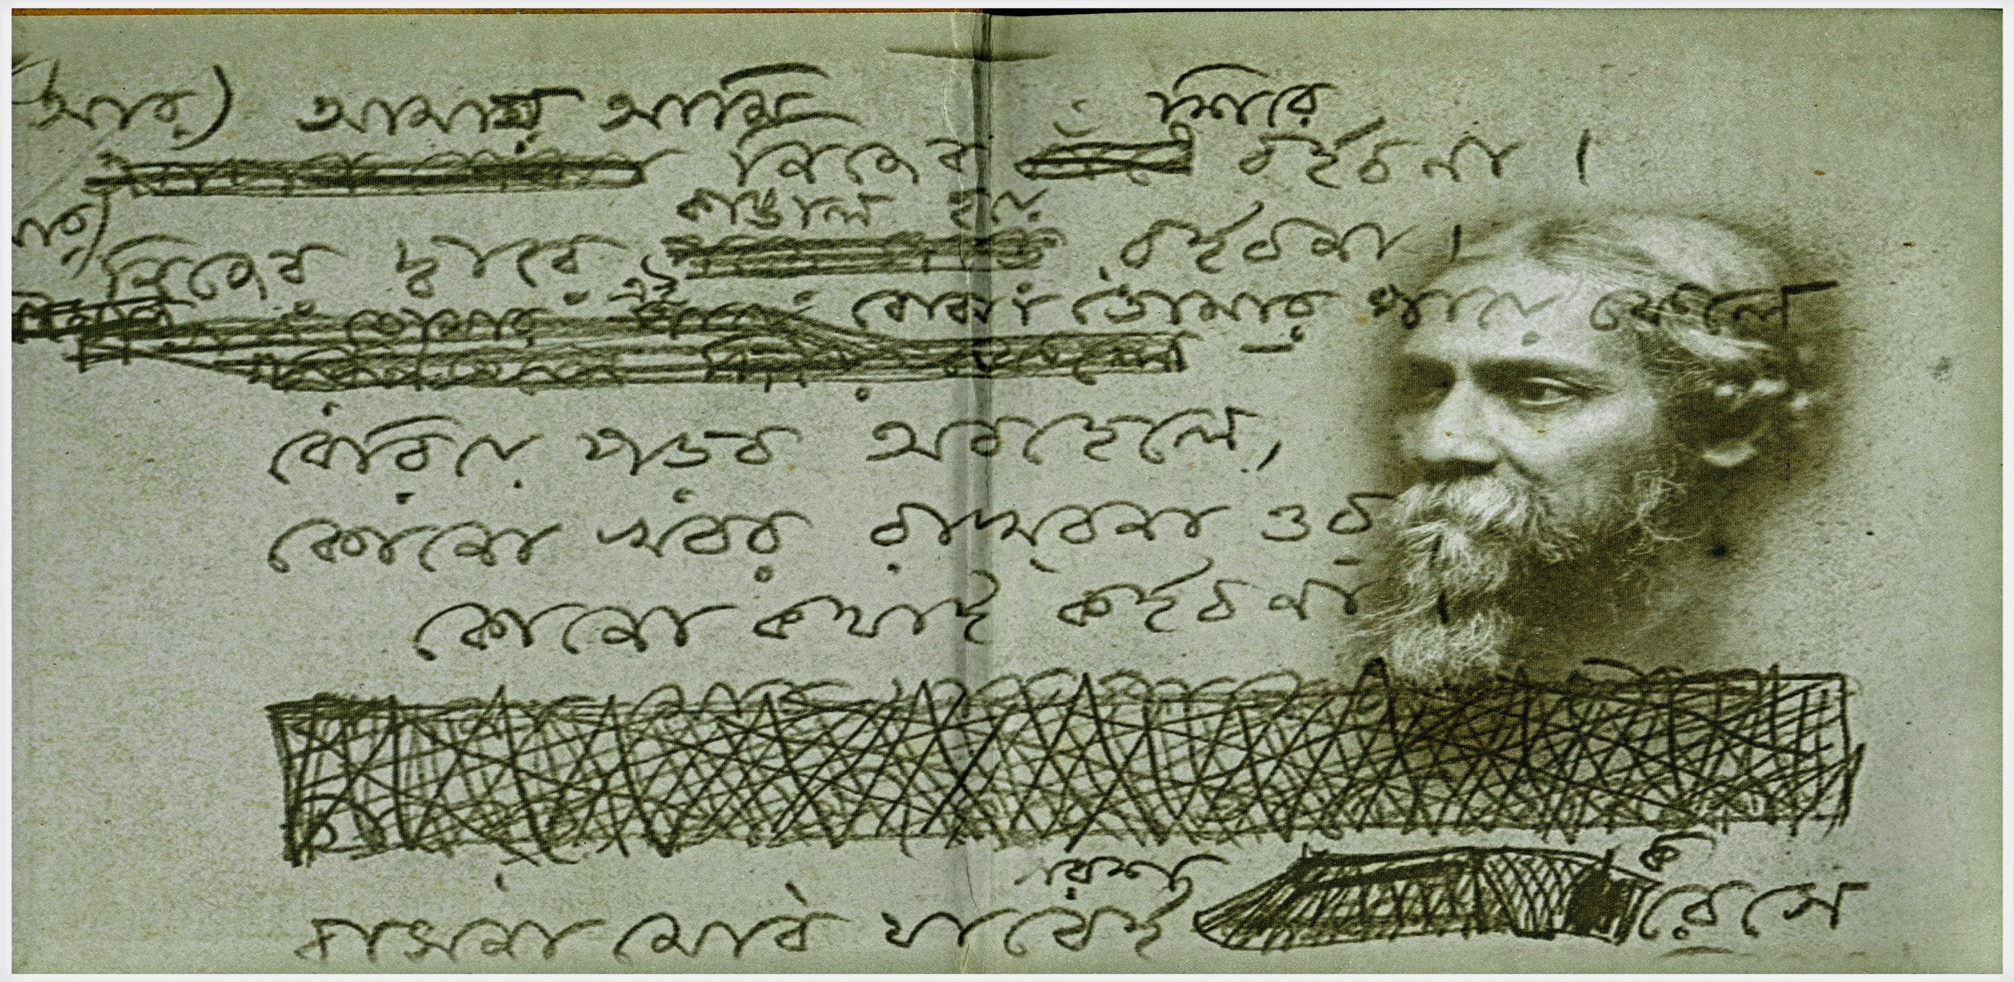
GITANJALI

Slide 5
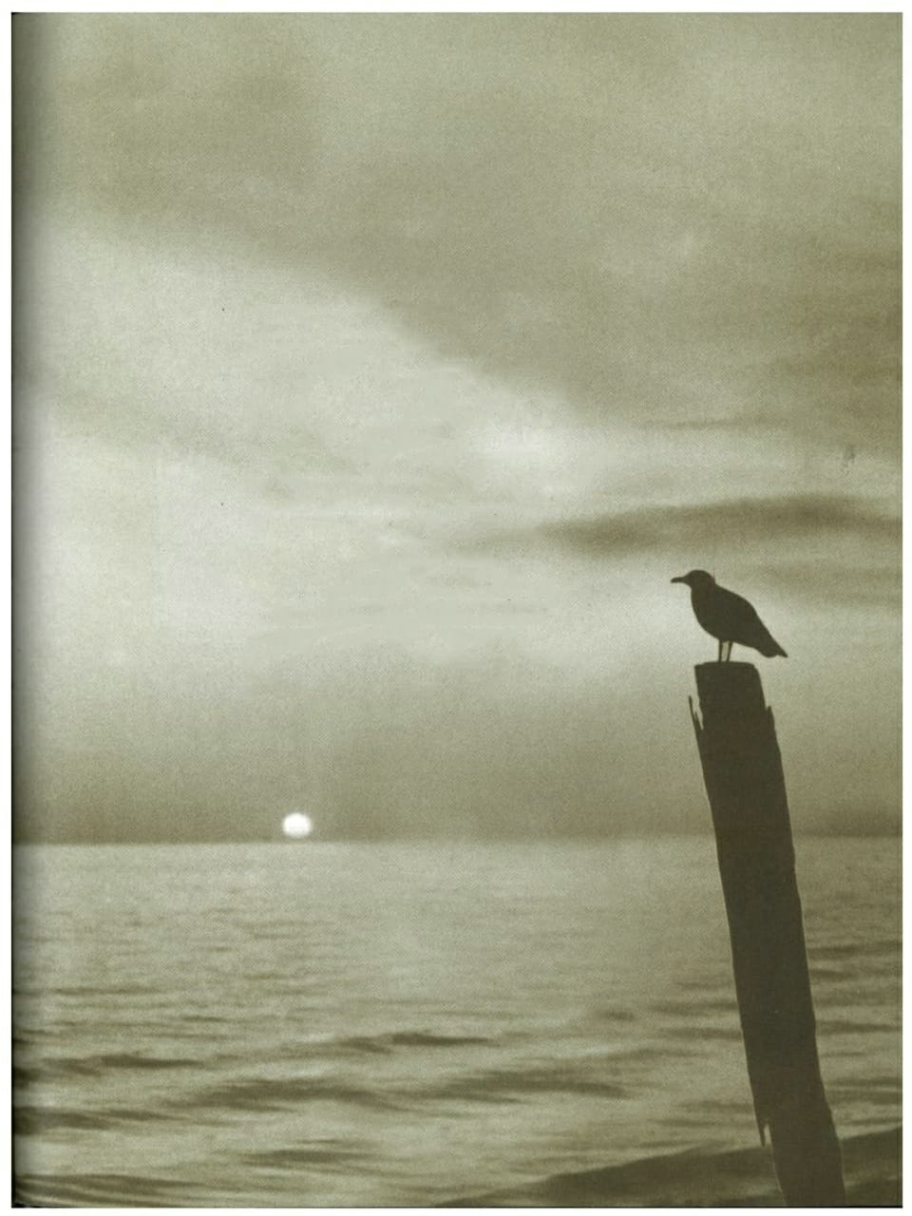
BACKGROUND OF THE STUDY
The study focuses on correlation of nature spirituality and healing from the select verses of Psalms and Gitanjali

Slide 6
RESEARCH QUESTIONS
Is there a similarity in the portrait of Nature from a literary and spiritual point of views..?
Is there a scope of application of NBT and its healing effects in the literary contexts as much as the real life contexts.?
Do we have ample evidence in literature like spirituality, to substantiate that Nature has therapeutic effects of restoring health and peace.?
Is there a parallelism between Divine, Nature and Humanity in Psalms and Gitanjali.?

Slide 7
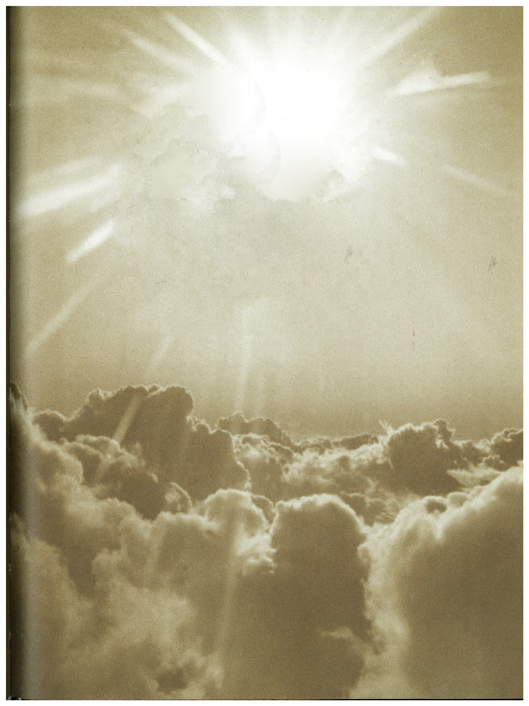
OBJECTIVES
To identify spirituality in the elements of Nature through contemplating on Nature.
To understand and experience the therapeutic effects of Nature and natural landscapes by living close to it and being healed by it.
To study the portrayal of nature in literature and understand its spiritual significance with reference to the literary texts of Gitanjali and Psalms.
To Examine the Practical concepts of Therapeutic Landscapes , Nature Based Therapy
(NBT) in real life contexts as an application of Free Air Living and its healing effects in the mind, body and spirit.

Slide 8
HYPOTHESIS
Nature becomes a medium of restoring health and peace. It can bring in the transformation and transcendence of human nature or character like no other medium could.
As much as the Nature, Literature also creates a healing space, keeping the human minds in the comfort zones, as the peacefulness in the landscapes portrayed, creates a mental landscape that reflects the peace, harmony and the solace formed there.

Slide 9
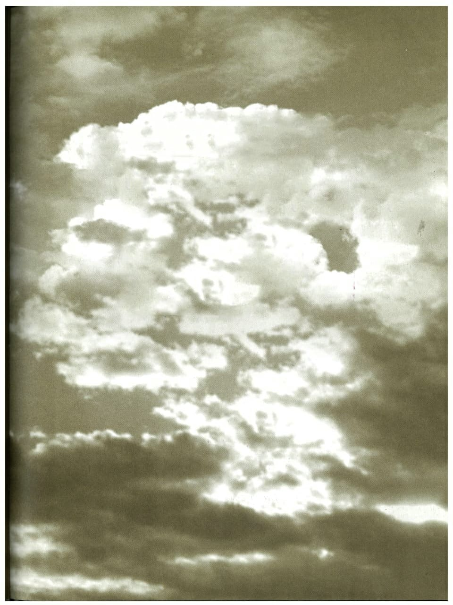
REVIEW OF LITERATURE – OVERVIEW

Slide 10
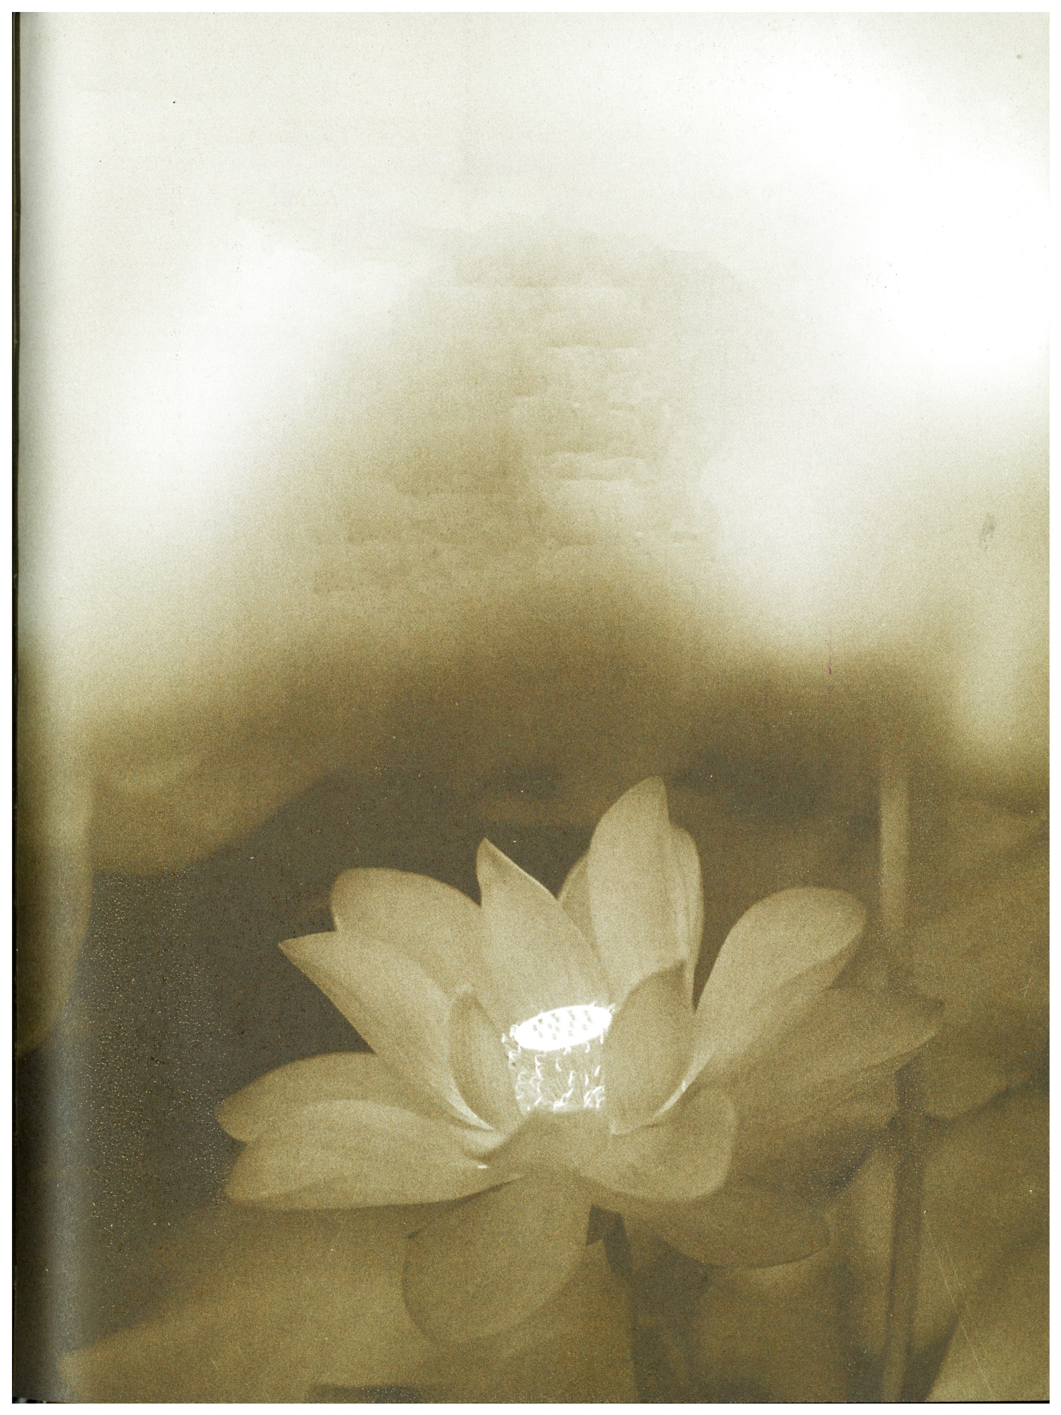
SECTION 1 - REVIEWS ON AUTHORIAL DESCRIPTION
Tagore’s Thoughts on Environment, written by Atiur Rahman on 03 June 2011, published in ‘The Daily Star’.

Slide 11
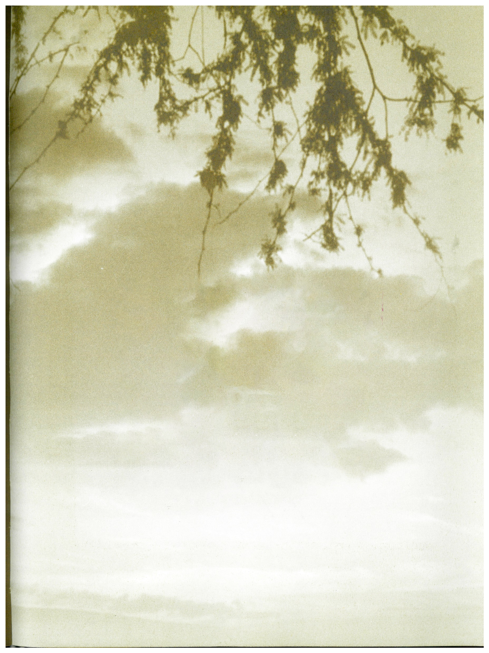
SECTION 2 – REVIEWS ON TEXTUAL ANALYSIS OF PSALMS
The Psalms and Spirituality: A Study on meditative engagement with selected Psalms among Edinburgh Students, 2007 (Ph.D. Thesis)

Slide 12
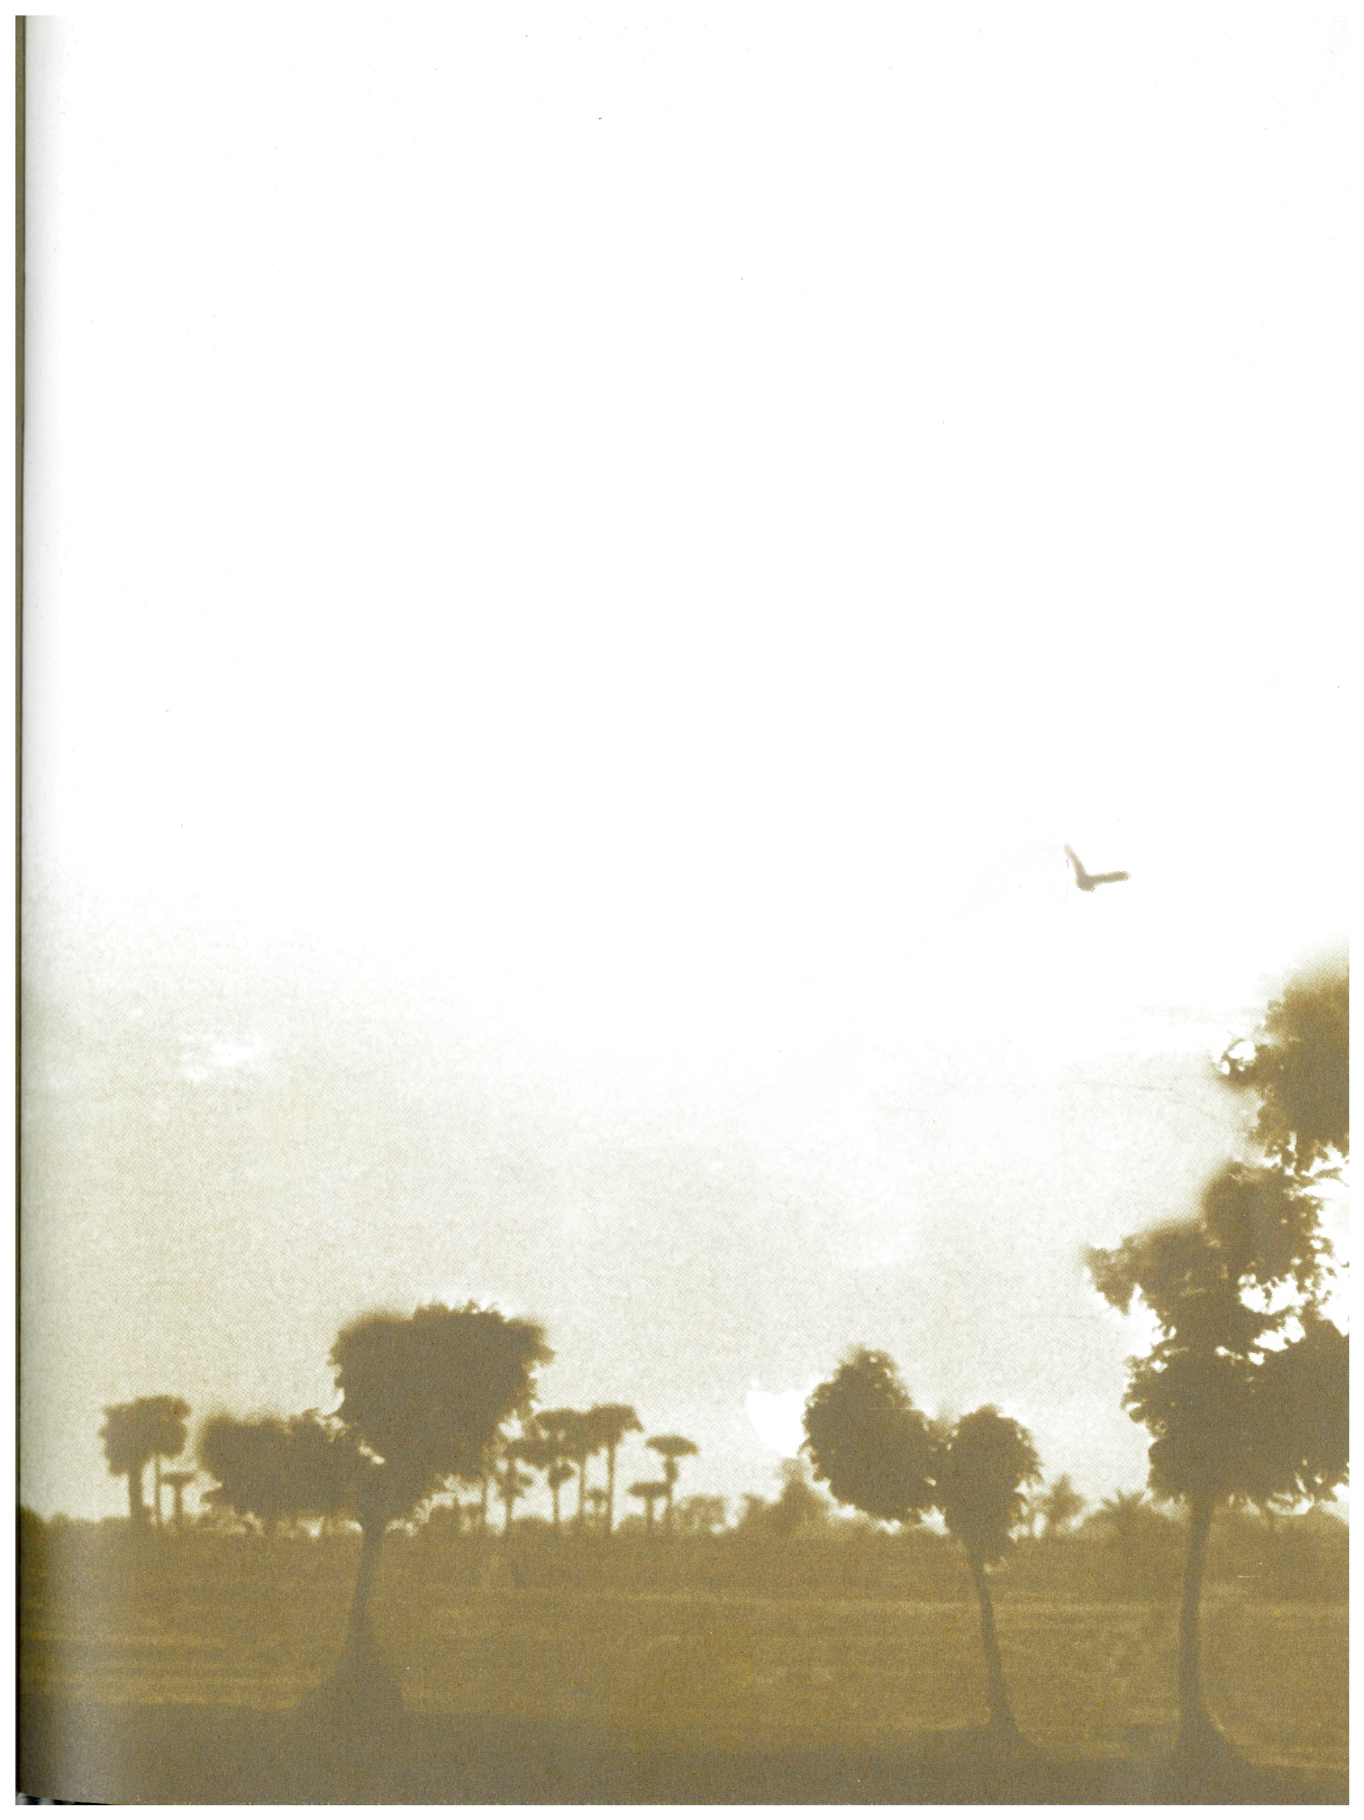
SECTION 3 – REVIEWS ON GITANJALI
'' Divinity as the manifestation of Nature and Man.- The Gitanjali.'' by Rasmi Rana,Np,nd.Web.3 May 2019.

Slide 13
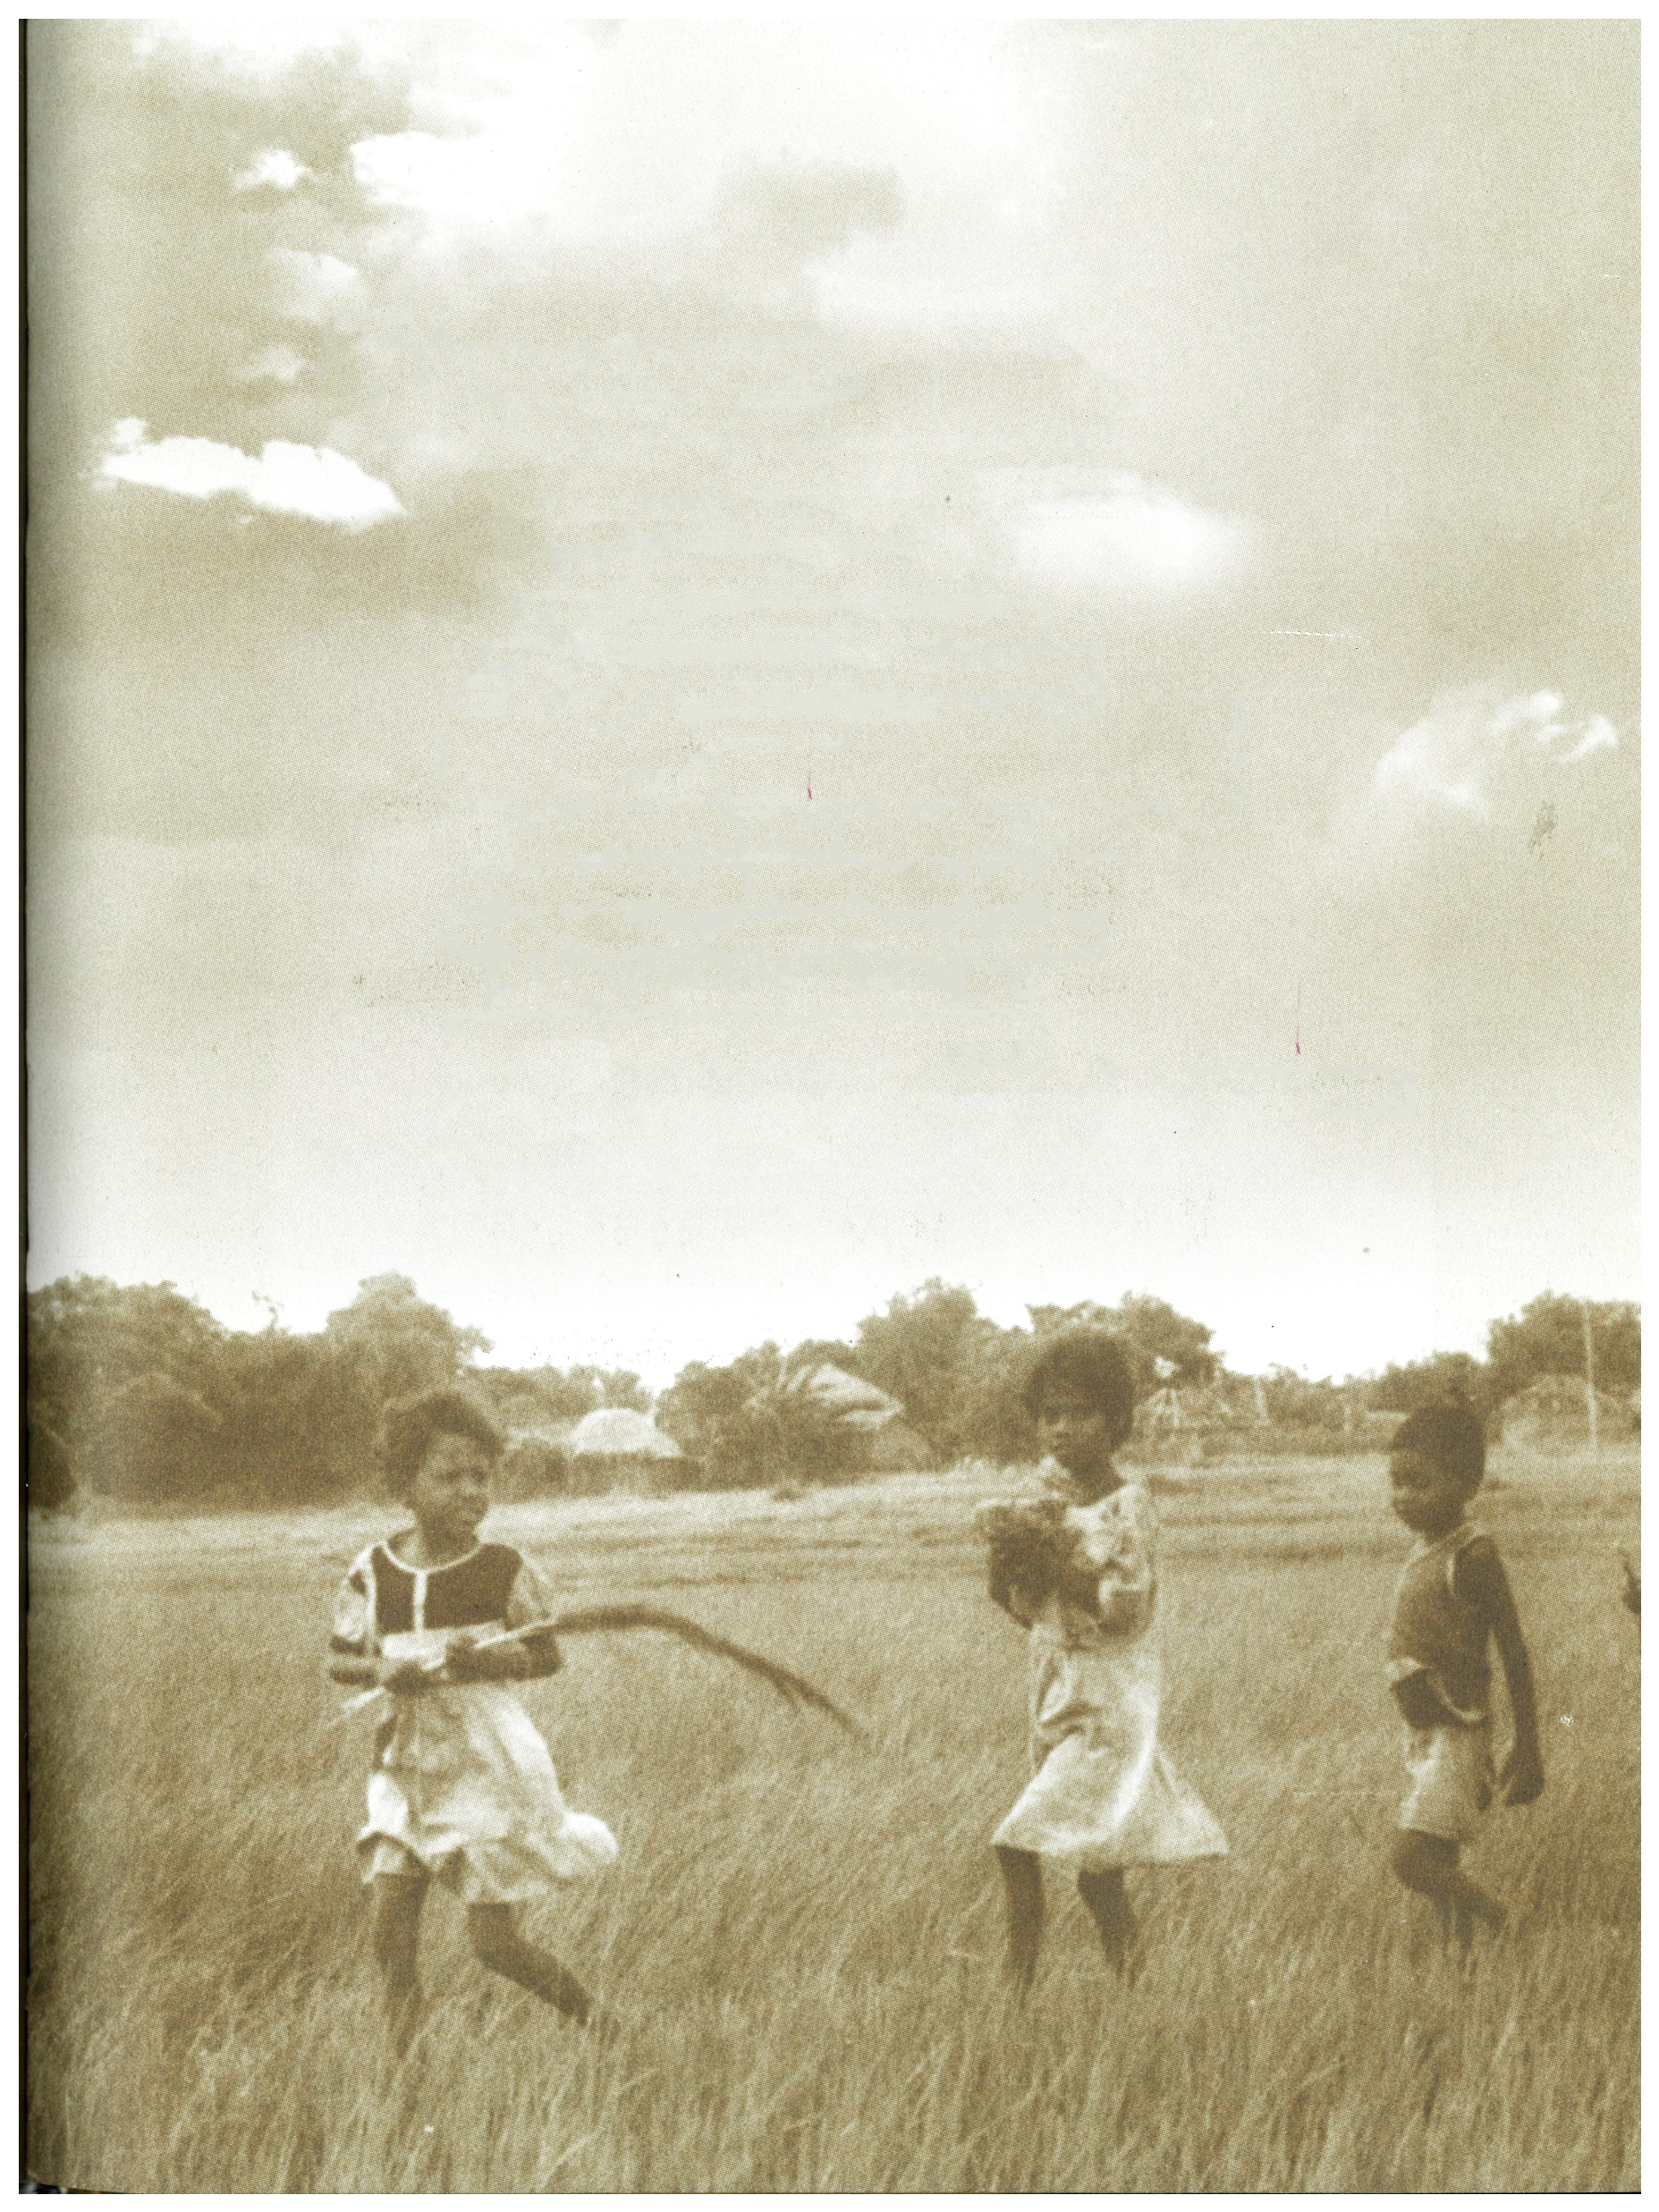
SECTION 4 – REVIEWS ON NATURE AS THERAPY
''Nature, Mind and Medicine; ‘A model for mind body healing.’ by Jason A Kaufman, 2018

Slide 14
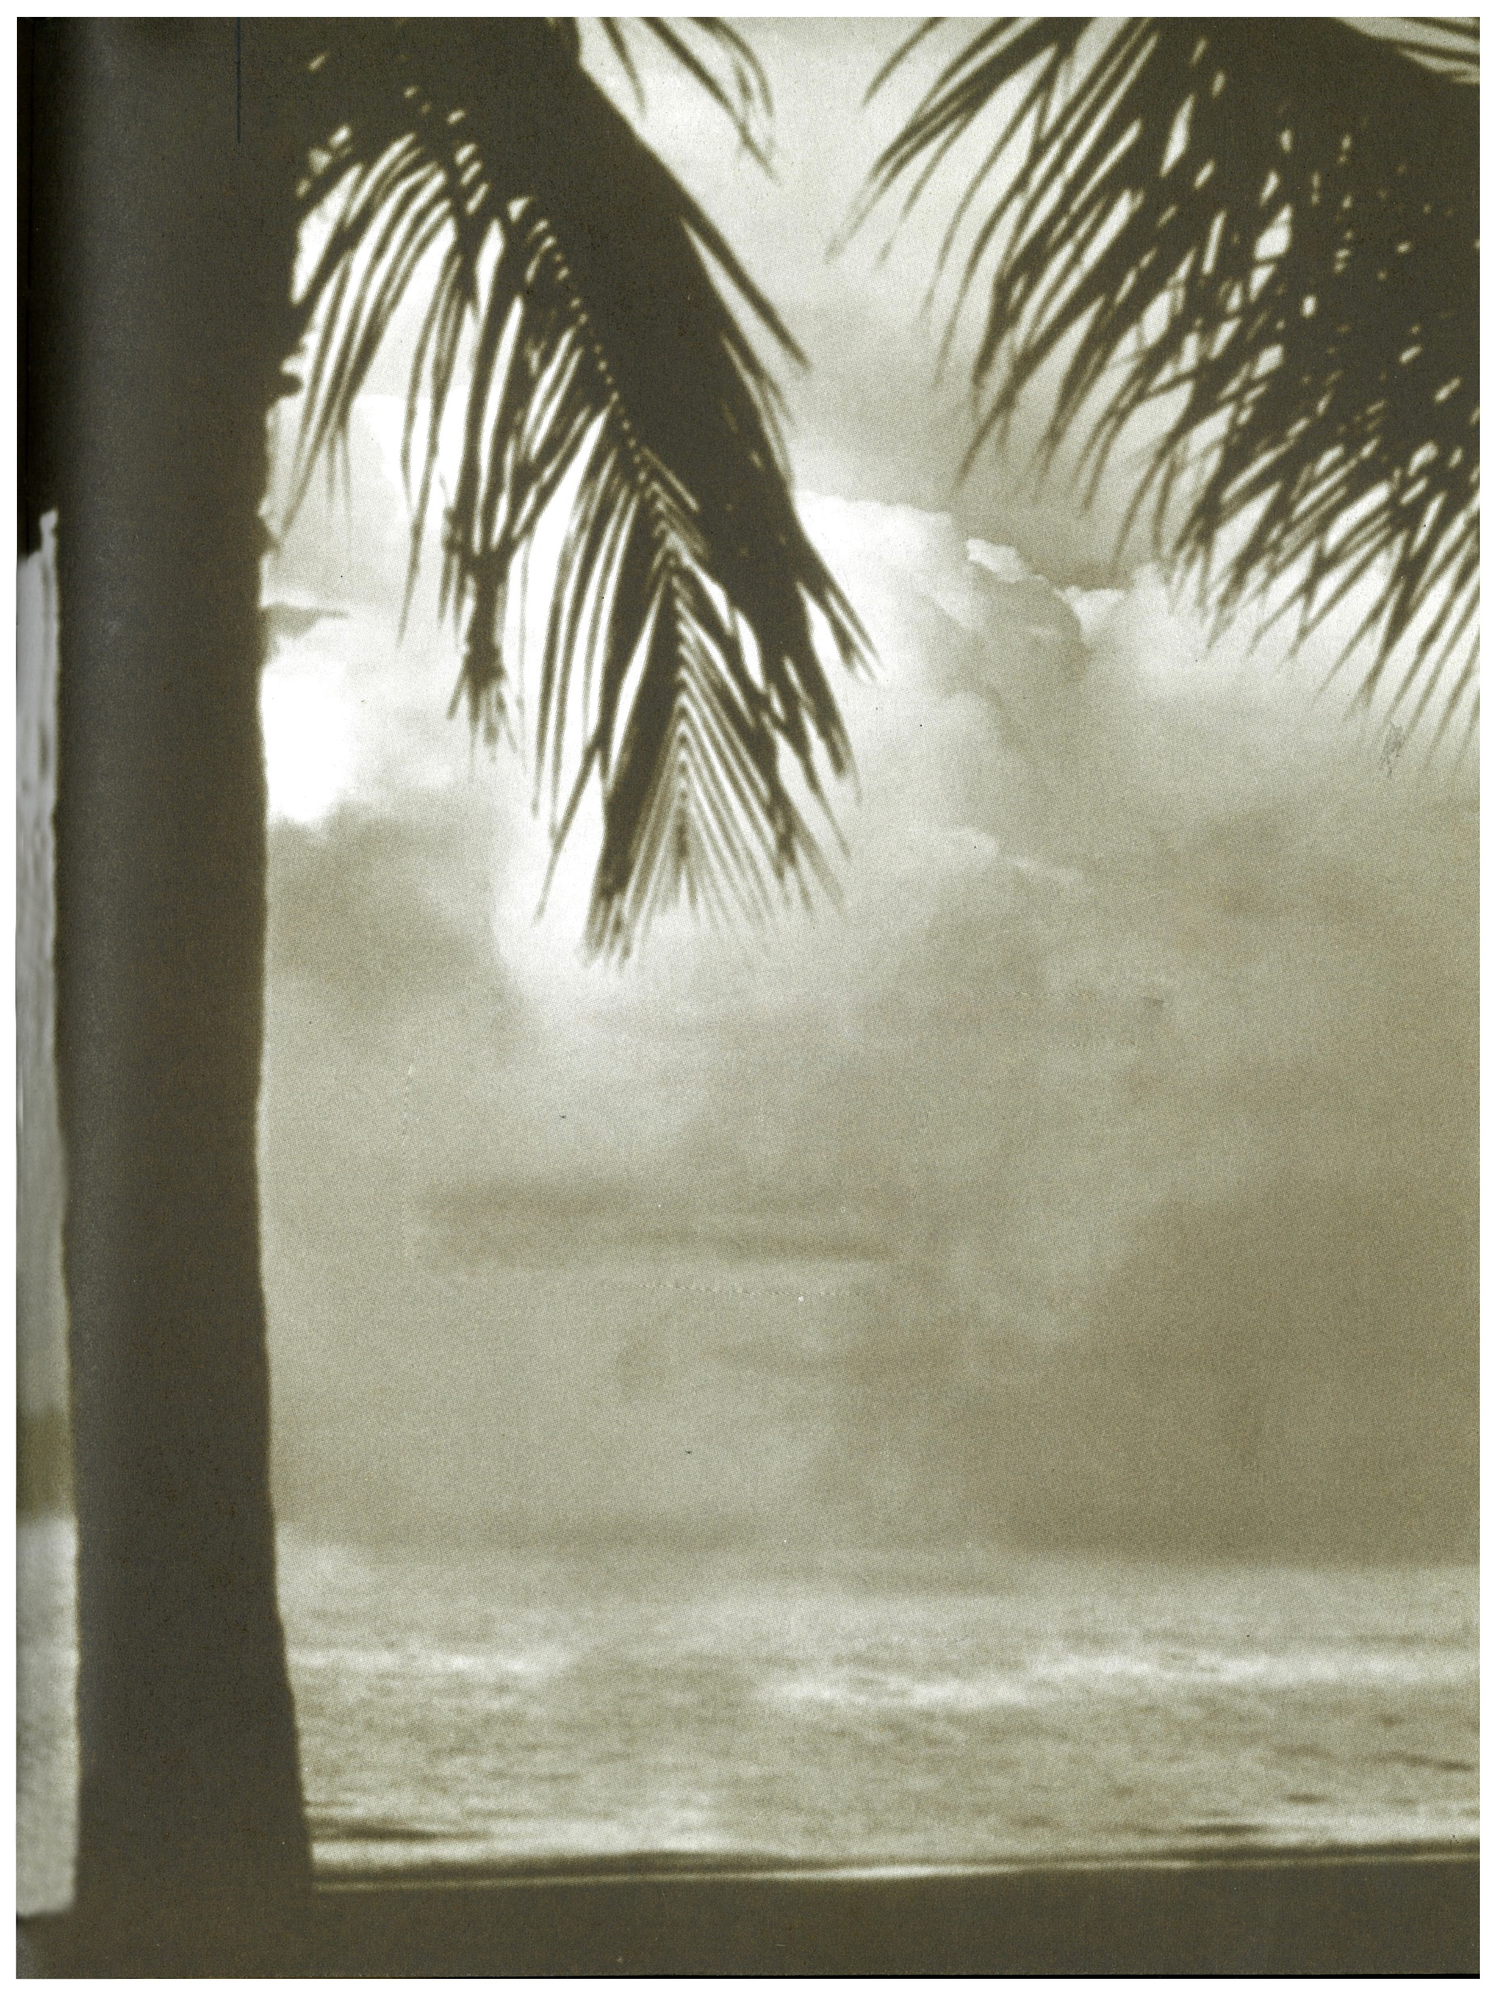
RESEARCH GAP
PSALMS
GEETANJALI
Therapeutic Perception of Nature

Slide 15
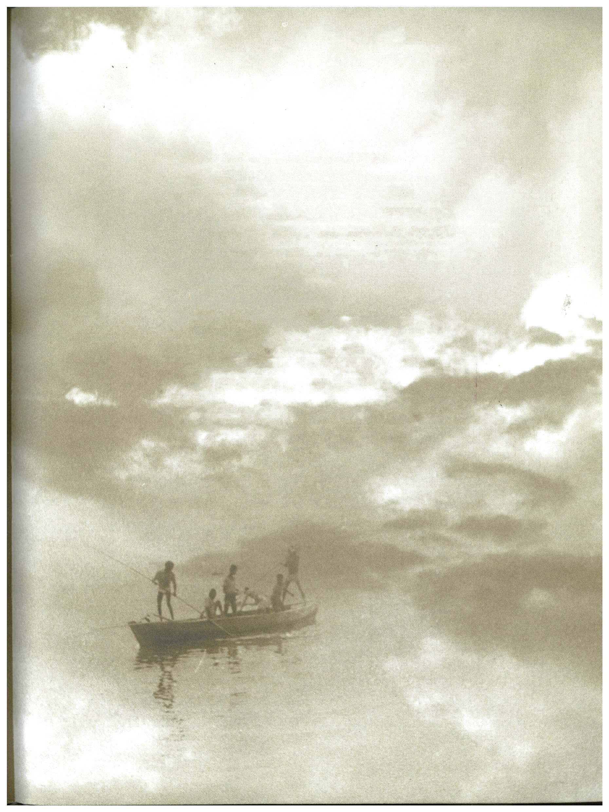
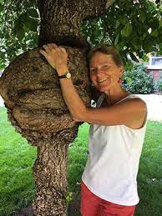
THEORITICAL FRAMEWORK
Green Writing- reflections on human interaction and nature
Cheryll Goltfelty, 1996
Eco- Criticism
The present study examines the select reference to the perspectives on Eco-criticism which believes that nature is the force behind evolution of a society. The theory is proposed by Cheryll Goltfelty, 1996, University of Georgia Press, her essays in the Eco-criticism readers explore on Green Writing and her reflections on human interaction and nature.

Slide 16
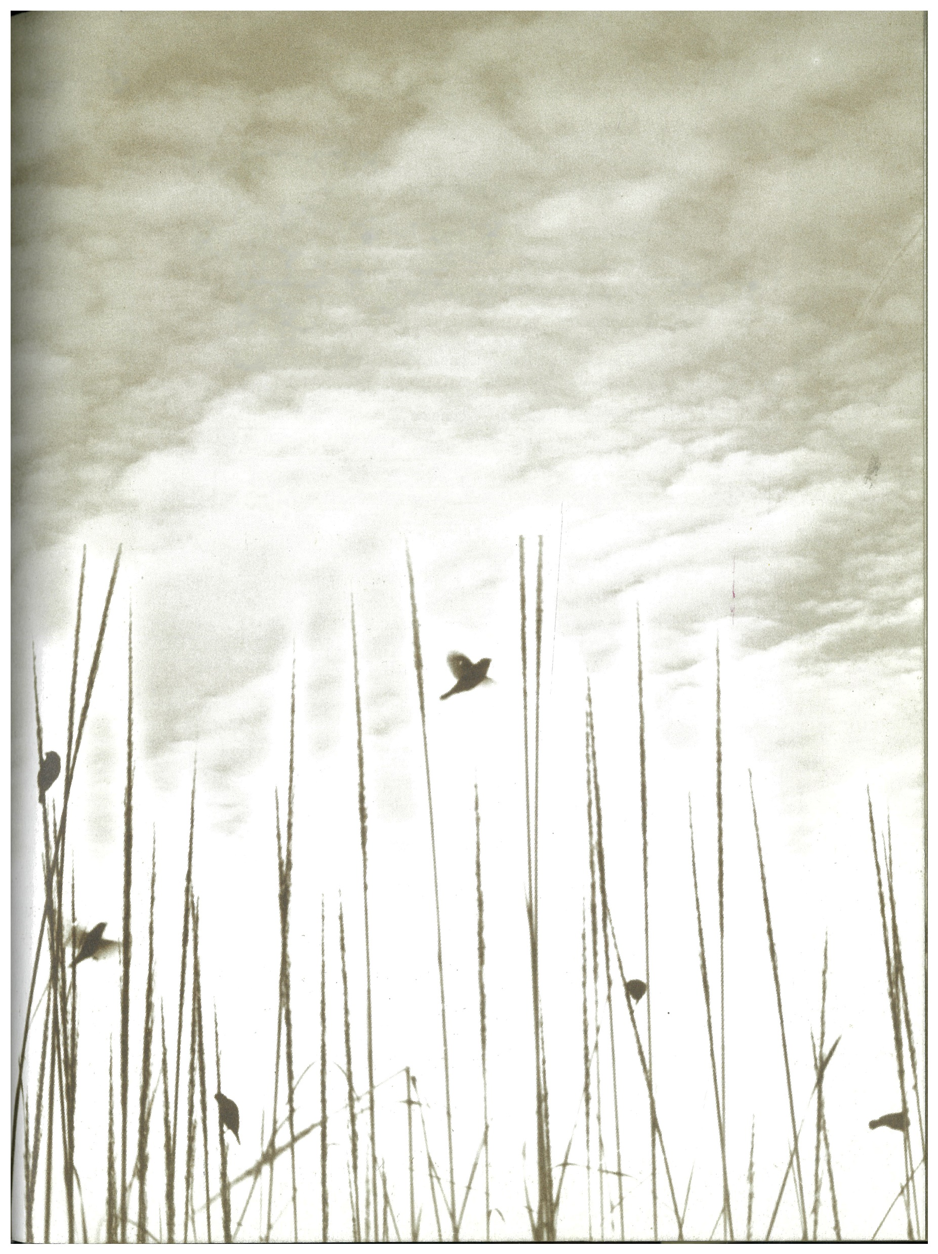
CONCEPTUAL FRAMEWORK
THERAPEUTIC LANDSCAPES
ECOFAITH AND HEALING SPACES
NATURE – BASED THERAPY (NBT)

Slide 17
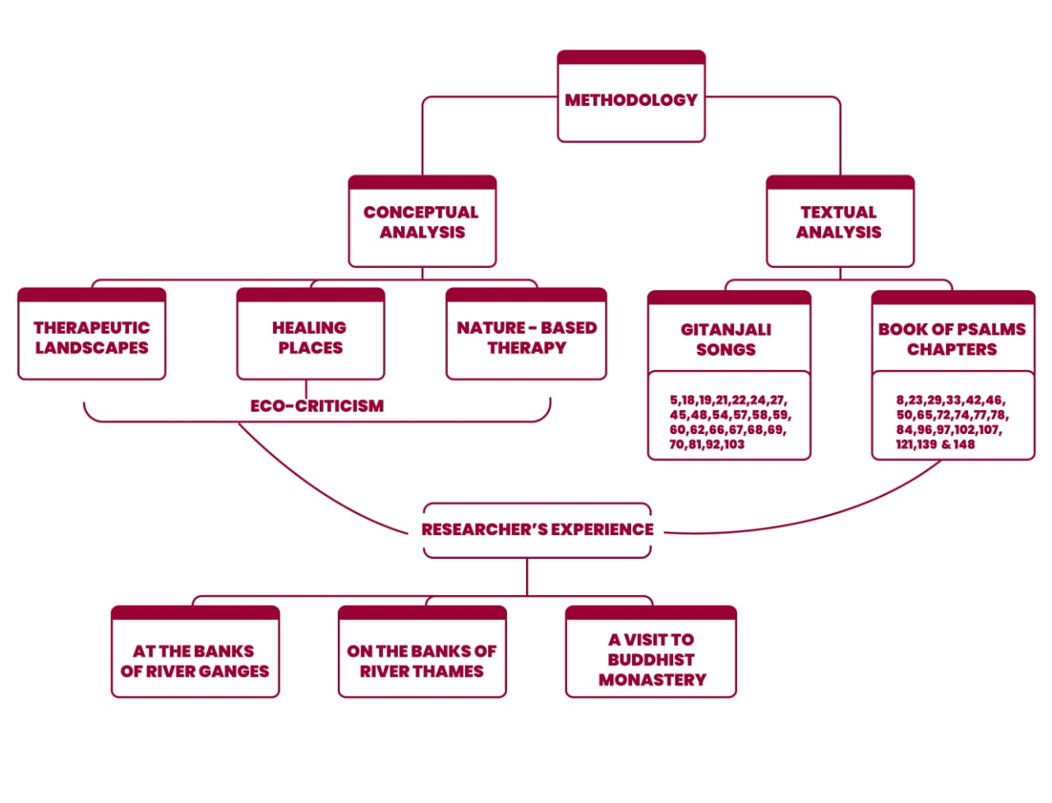
METHODOLOGY

Slide 18
ANALYSIS
CONCEPT OF THERAPEUTIC LANDSCAPE
WITH REFERENCE TO GITANJALI SONG - 69
The same stream of life that runs through my veins
night and day runs through the world
and dances in rhythmic measures.
………………………………………………….
………………………………………………….
I feel my limbs are made glorious
by the touch of this world of life.

Slide 19
CONCEPT OF THERAPEUTIC LANDSCAPES WITH REFERENCE TO PSALM - 65
The whole earth is filled with awe at your wonders;
where morning dawns, where evening fades,
you call forth songs of joy.
You care for the land and water it;
you enrich it abundantly.

Slide 20
ANALYSIS OF ECOFAITH AND HEALING SPACES WITH REFERENCE TO GITANJALI SONG - 67
Thou art the sky and thou art the nest as well.
O thou beautiful, there in the nest
it is thy love that encloses the soul
with colours and sounds and odours.
There comes the morning
with the golden basket in her right hand
bearing the wreath of beauty,
silently to crown the earth.

Slide 21
ANALYSIS OF ECOFAITH AND HEALING SPACES WITH REFERENCE TO PSALMS - 104
He stretches out the heavens like a tent and lays the beams of his upper chambers on their waters. He makes the clouds his chariot and rides on the wings of the wind…………………………………………………………
………………………….............................................................................
May the glory of the Lord endure forever; may the Lord rejoice in his works— he who looks at the earth, and it trembles, who touches the mountains, and they smoke. I will sing to the Lord all my life; I will sing praise to my God as long as I live.

Slide 22
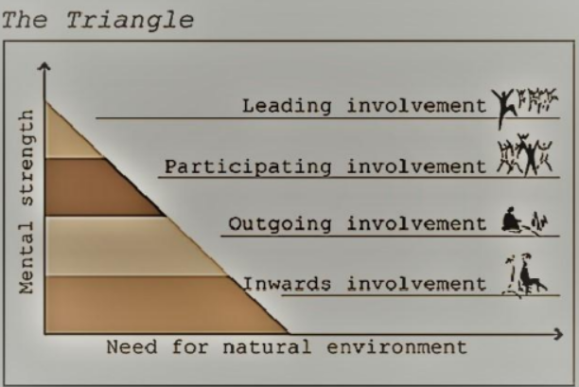
NATURE BASED THERAPY

Slide 23
CONCEPT OF NATURE BASED THERAPY (NBT) WITH REFERENCE TO GITANJALI SONG - 81
Hidden in the heart of things thou art
nourishing seeds into sprouts, buds into blossoms,
and ripening flowers into fruitfulness.
I was tired and sleeping on my idle bed
and imagined all work has ceased.
In the morning I woke up and found
my garden full with wonders of flowers.

Slide 24
CONCEPT OF NATURE – BASED THERAPY WITH REFERENCE TO PSALMS - 23
The LORD is my shepherd, I shall not be in want. He makes me lie down in green pastures, he leads me beside quiet waters, he restores my soul. He guides me in paths of righteousness for his name's sake. Even though I walk through the valley of the shadow of death, I will fear no evil, for you are with me; your rod and your staff, they comfort me. You prepare a table before me in the presence of my enemies.

Slide 25
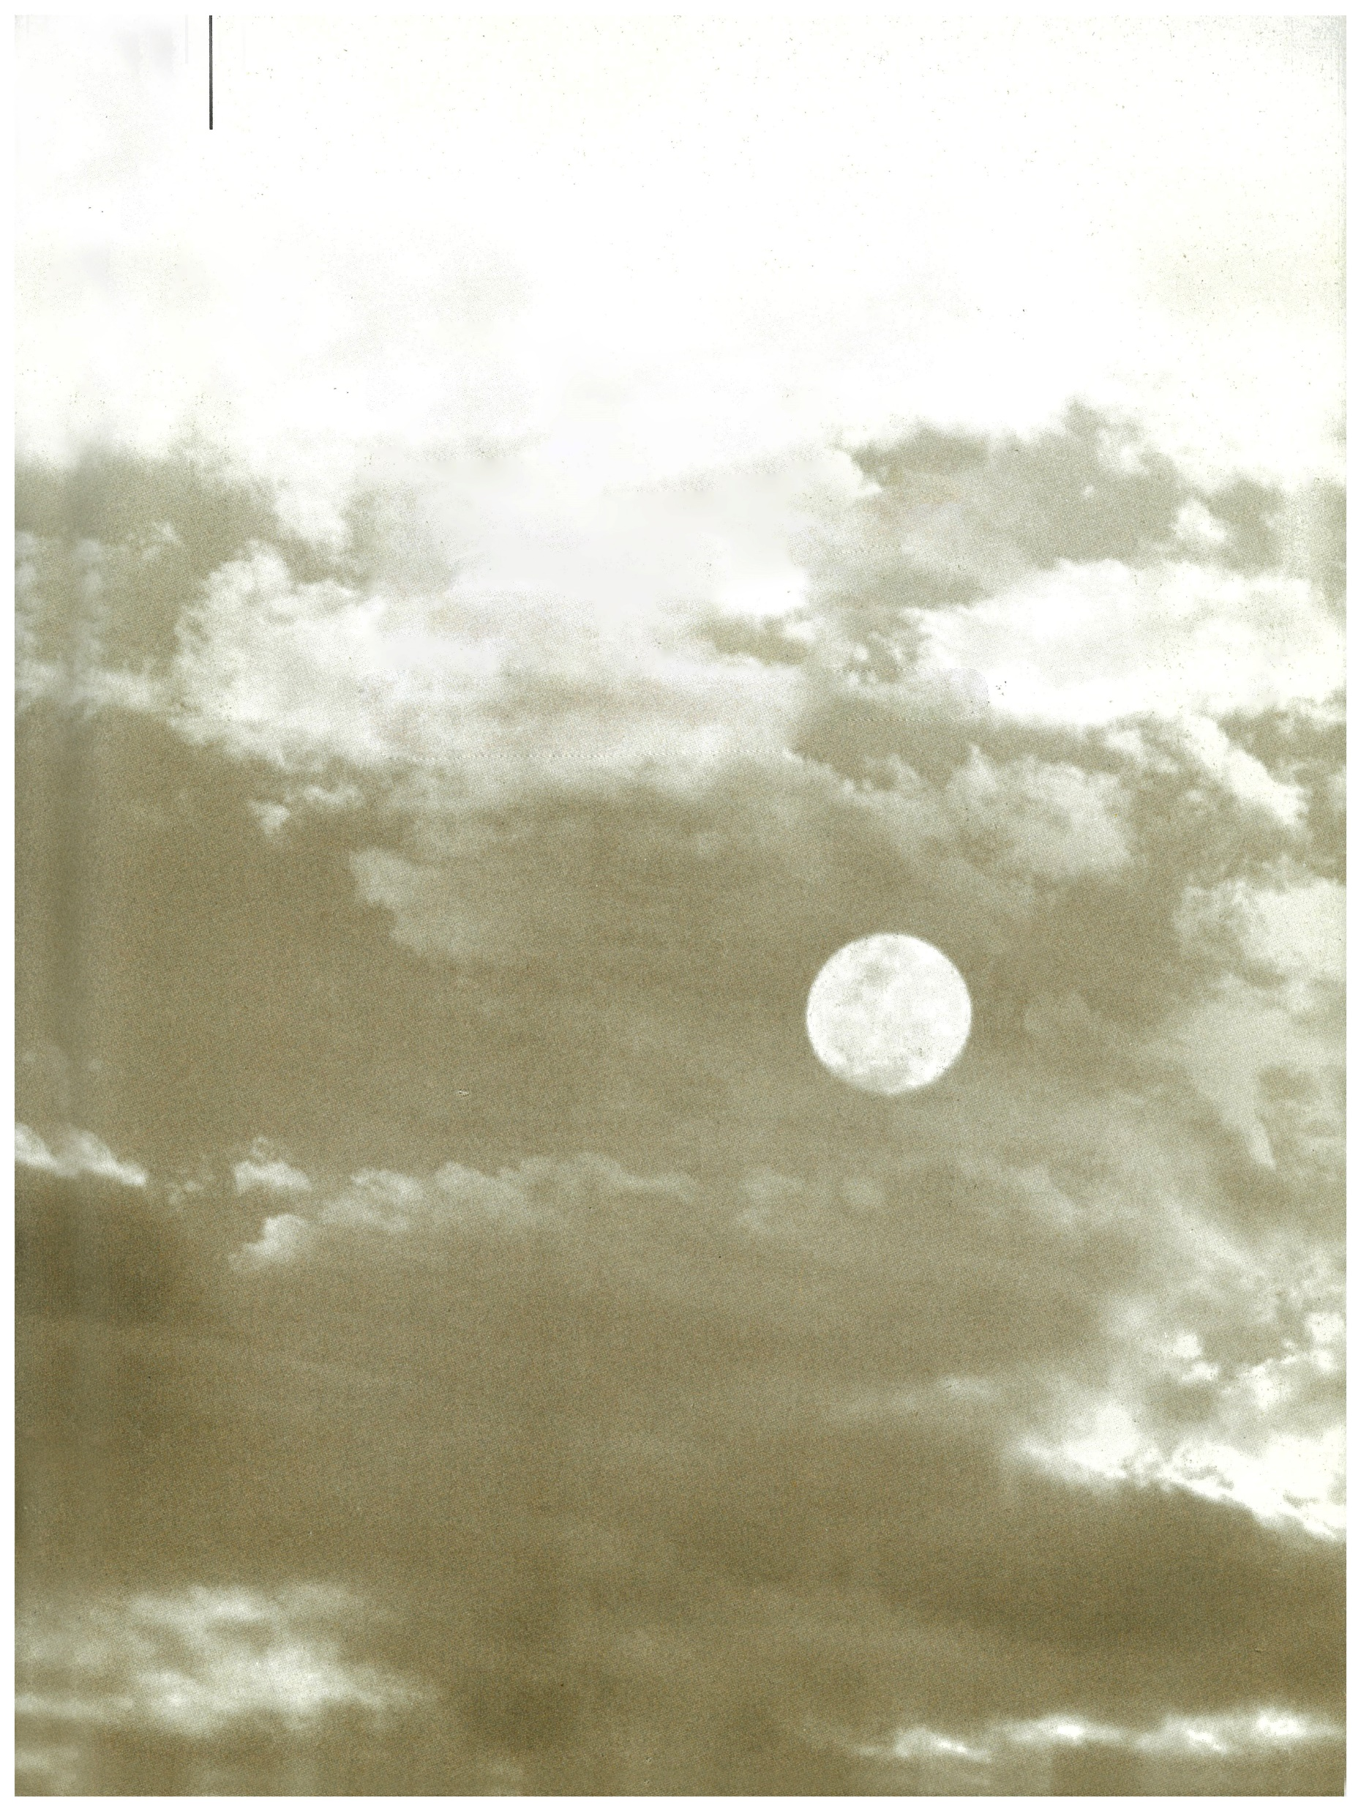
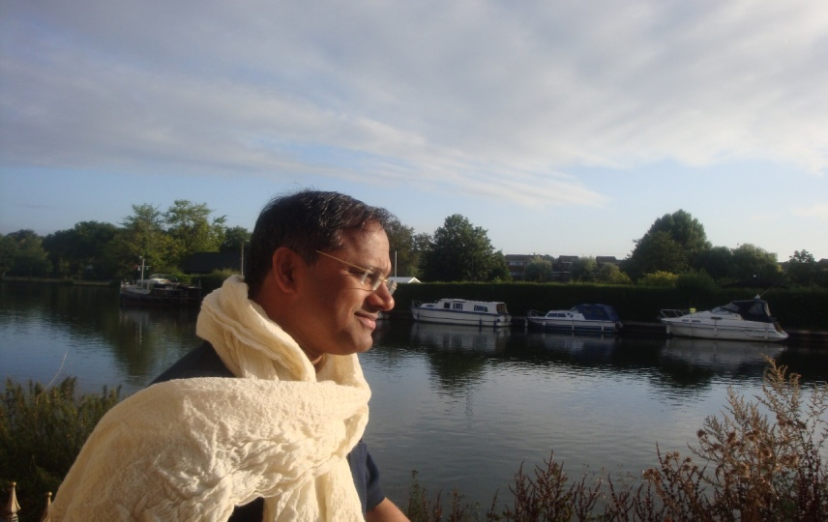
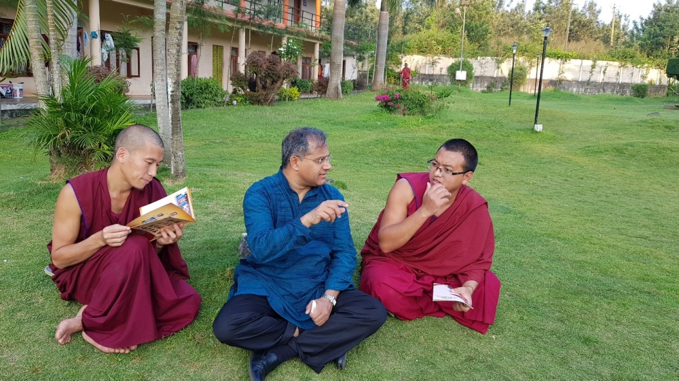
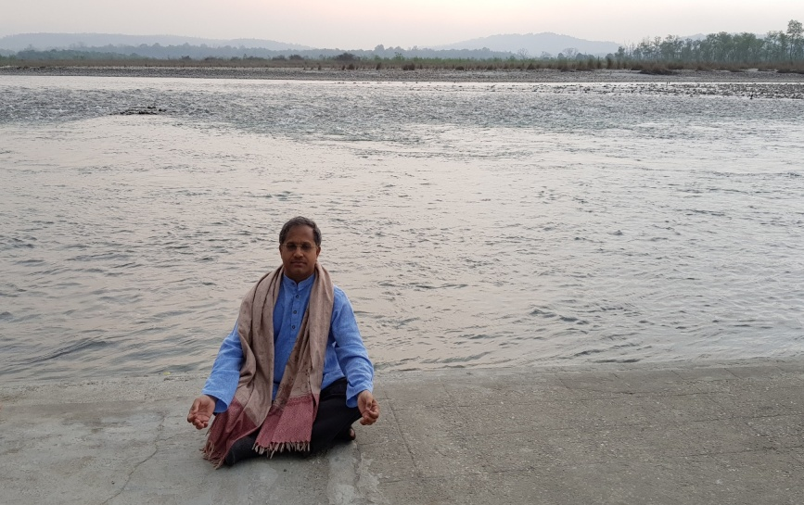
THERAPEUTIC LANDSCAPES, HEALING SPACES AND NATURE BASED THERAPY
At the banks of River Thames
Visit to a Buddhist Monastery
At the banks of River Ganges

Slide 26
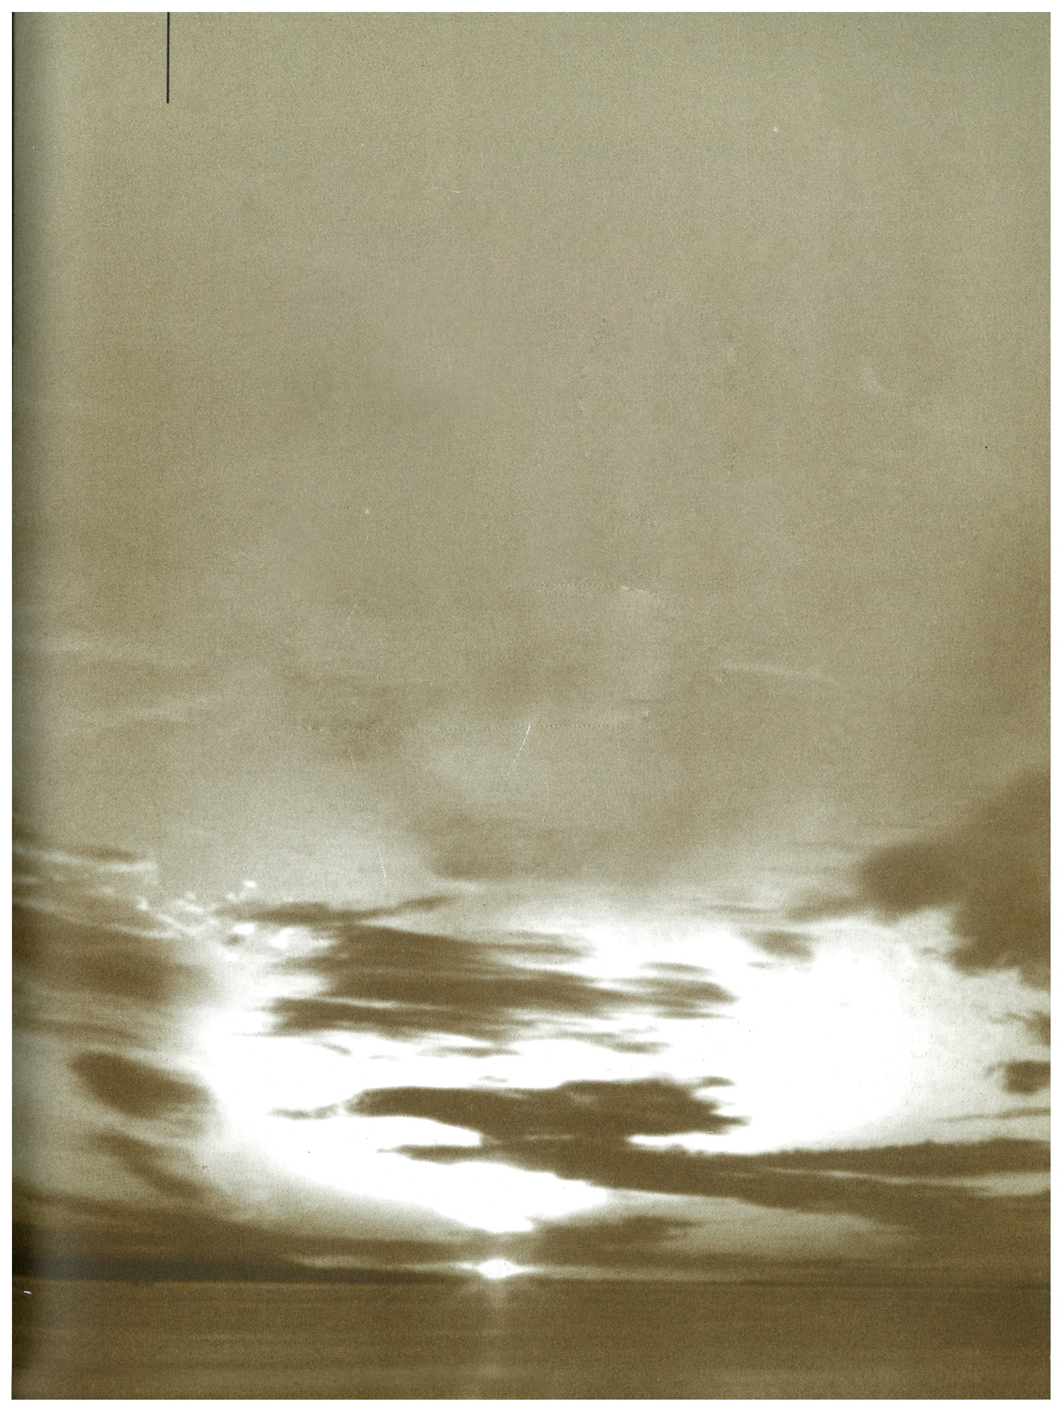
RELEVANCE OF THE STUDY
Modern man has detached from nature and continues to see them as a separate entity from the natural world.
Capitalization and modernization has exploited nature to attain the perfect luxurious lives for humans at the cost ecological degeneration.
Anthropocentrism is at the heart of modernity.

Slide 27
RELEVANCE OF THE STUDY
Nature Therapy is highly significant and is emerging all over the world, helping people cope with trauma and accept life.
Nature a sense of identification and experience revival and renewal of body, mind and spirit.
The study reinforces the importance of nature in human lives.

Slide 28
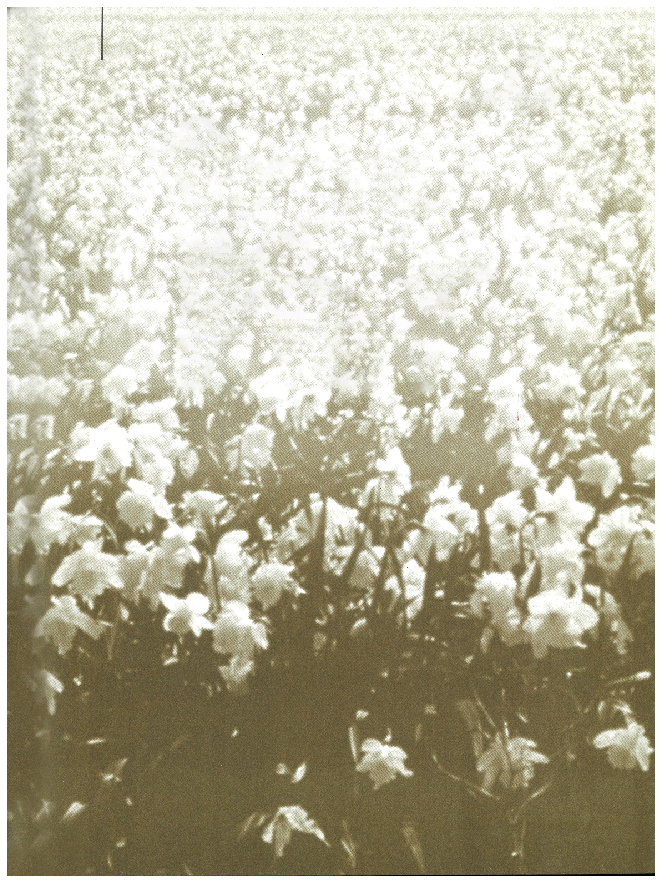
MAJOR FINDINGS
Nature is a treasure house of wisdom, resources and spiritual energy vital for the survival of human beings and sustenance of the universe
When people connect to nature, they actually are reconnecting to themselves
Nature mediates between the divine and the humanity
Nature has multidimensional perspectives and possesses the power to heal

Slide 29
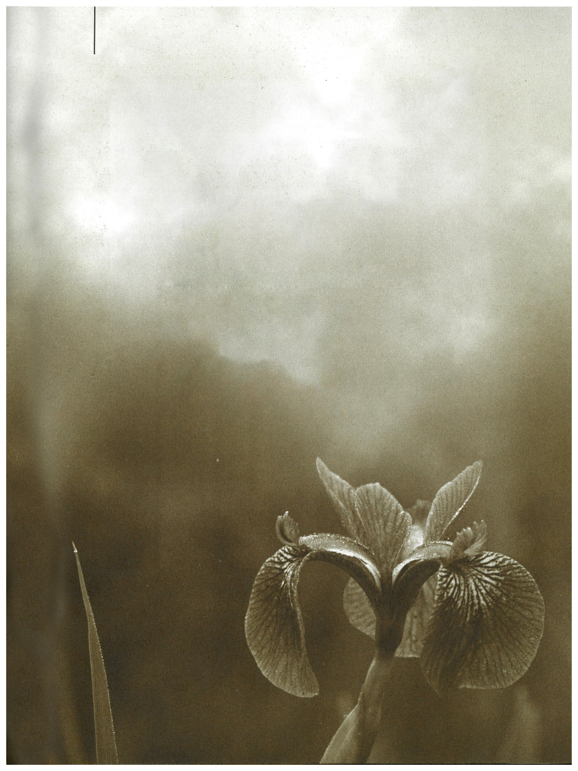
LIMITATIONS OF THE STUDY
Due to constraints of time, the researcher could not extend the research to include any field work and had to limit the study to the textual analysis of Rabindranath Tagore’s Gitanjali and select Psalms from the Bible.

Slide 30
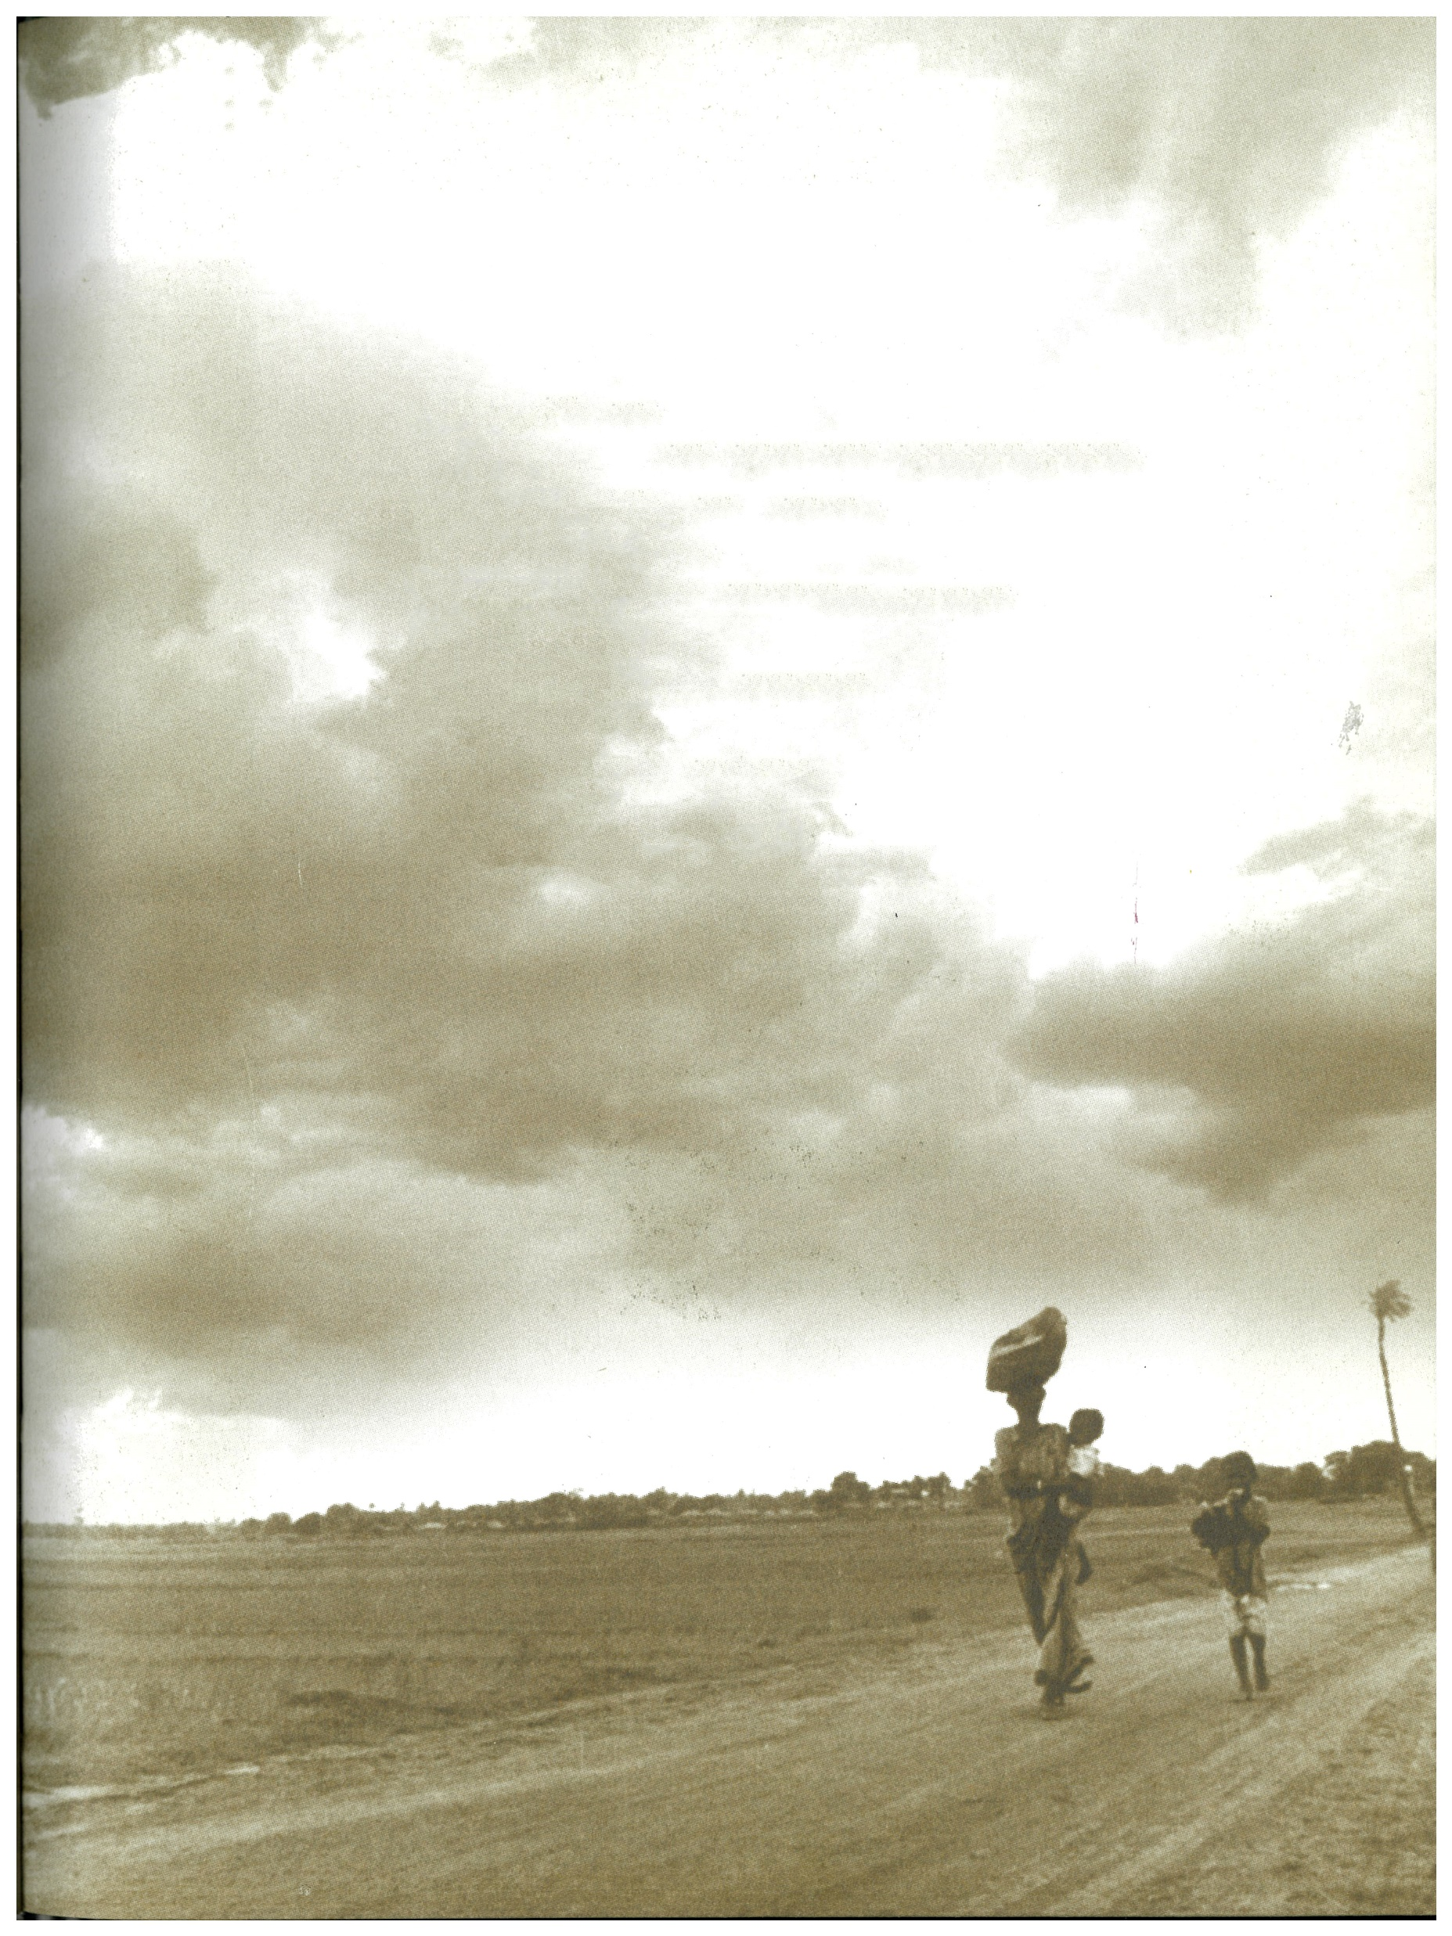
SCOPE FOR FURTHER RESEARCH
Research about Therapeutic Landscapes can be done, studying and understanding how natural landscapes work and heal ultimately.
Studies can be done on the practical approaches of Nature Therapy carrying out field work and recording the experiences of the clients and their healing after the therapy.
Nature Therapy can be collaborated with other disciplines to attain healthcare and healing more effectively, using language as another factor in the therapeutic process.
Literary analysis and critical study of eco-fiction can be researched, analysing the natural phenomenon and their effects on the characters.

Slide 31
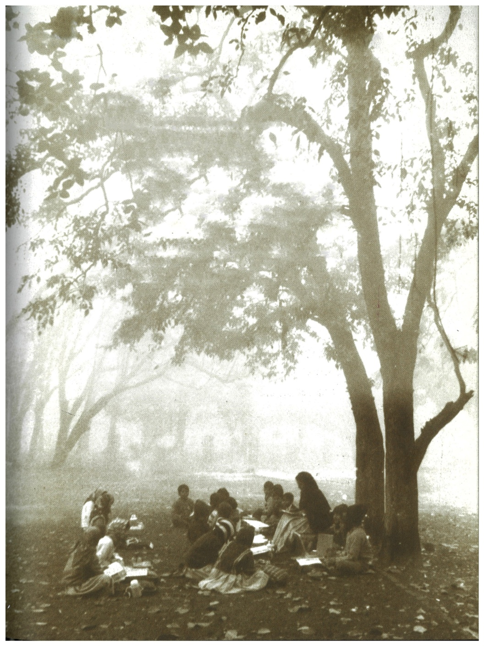
Thank You..

